Slide 1
Women’s Health in General Practice
Intern Induction- June 2024
Dr Trish Horgan, GP. Broad Lane Family Practice, Blackpool. Cork.

Slide 2
“ It’s the simple things that are really effective. Try to remember that”.
Theodore Sturgeon

Slide 3
Womens Health in 20 Mins!
Consider Pregnancy
Obstetric screening
Contraception framework
Infection reference
Common Gynaecological Problems
Cardiovascular Disease
Domestic violence/abuse and coercive control
Menopause Conversations

Slide 4
Benefits to early pregnancy detection
My explain presenting symptoms
May alter diagnostic/management plan
Therapeutic implications
Greatest risk factor for being prescribed a potentially risky drug in pregnancy is having a chronic disease. Eg Epilepsy, diabetes mellitus, hypertension, inflammatory bowel disease, chronic inflammatory arthritis . (Risk x 4 compared to women who do not have chronic illness)
Highest risk for drug based congenital anomalies is in the first trimester
Opportunity for folate supplementation (NTD affects 1/1000 pregnancies in Ireland)
Tronnes J, Lupattelli A, Nordeng H, Safety profile of medication used during pregnancy: results of a multinational European study, Pharmacoepidemiology and Drug safety 2017;26:802-811

Slide 5
CRITERIA FOR REASONABLY EXCLUDING PREGNANCY-
FACULTY OF SEXUAL AND REPRODUCTIVE HEALTH (FSRH)
Healthcare practitioners can be reasonably certain that a woman is not currently pregnant if any one or more of the following criteria are met and there are no symptoms or signs of pregnancy:
She has not had intercourse since the start of her last normal (natural) menstrual period, since childbirth, abortion, miscarriage, ectopic pregnancy or uterine evacuation for gestational trophoblastic disease. She has been correctly and consistently using a reliable method of contraception. (For the purposes of being reasonably certain that a woman is not currently pregnant, barrier methods of contraception can be considered reliable providing that they have been used consistently and correctly for every episode of intercourse.)
She is within the first 5 days of the onset of a normal (natural) menstrual period. She is less than 21 days postpartum (non-breastfeeding women). She is fully breastfeeding, amenorrhoeic AND less than 6 months postpartum. She is within the first 5 days after abortion, miscarriage, ectopic pregnancy or uterine evacuation for gestational trophoblastic disease.
She has not had intercourse for >21 days AND has a negative high-sensitivity urine pregnancy test (able to detect hCG levels around 20 mIU/ml).

Slide 6
CONFIRMING PREGNANCY
Do a pregnancy test! (Most detect serum HCG> 25iu)
If in doubt, repeat after 1 week interval OR serum Hcg

Slide 7
Women Seeking Pregnancy Options Support
HSE My Options Helpline
1850 818 010

Slide 8
Routine Antenatal Visit in General Practice
Advise about folic acid/vitamin D
Ask about smoking
Measure blood pressure. NB Women with metabolic risk.
Document symphysial fundal height(SFH) in cm
Look for asymptomatic bacteria (MSU to lab) and proteinuria
Ask about foetal movements
Screen for gestational diabetes mellitus in high risk groups

Slide 9
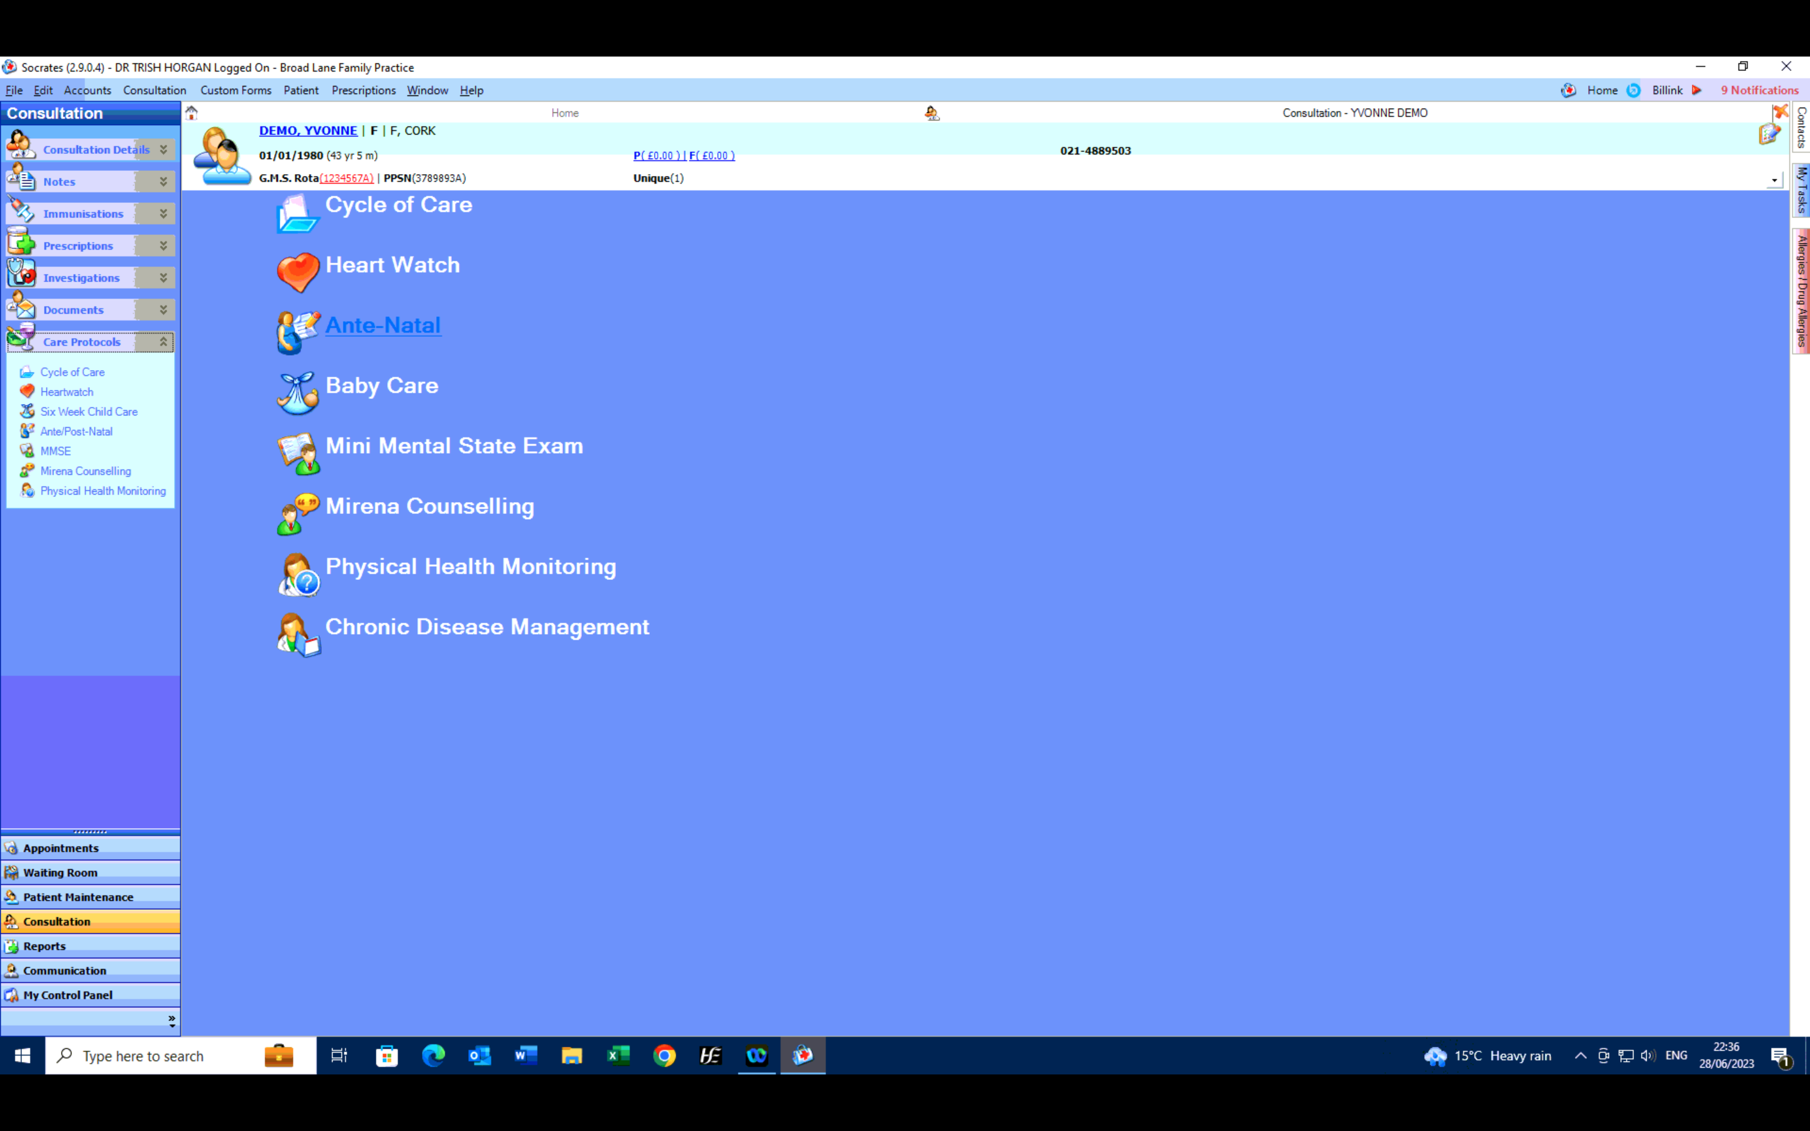

Slide 10
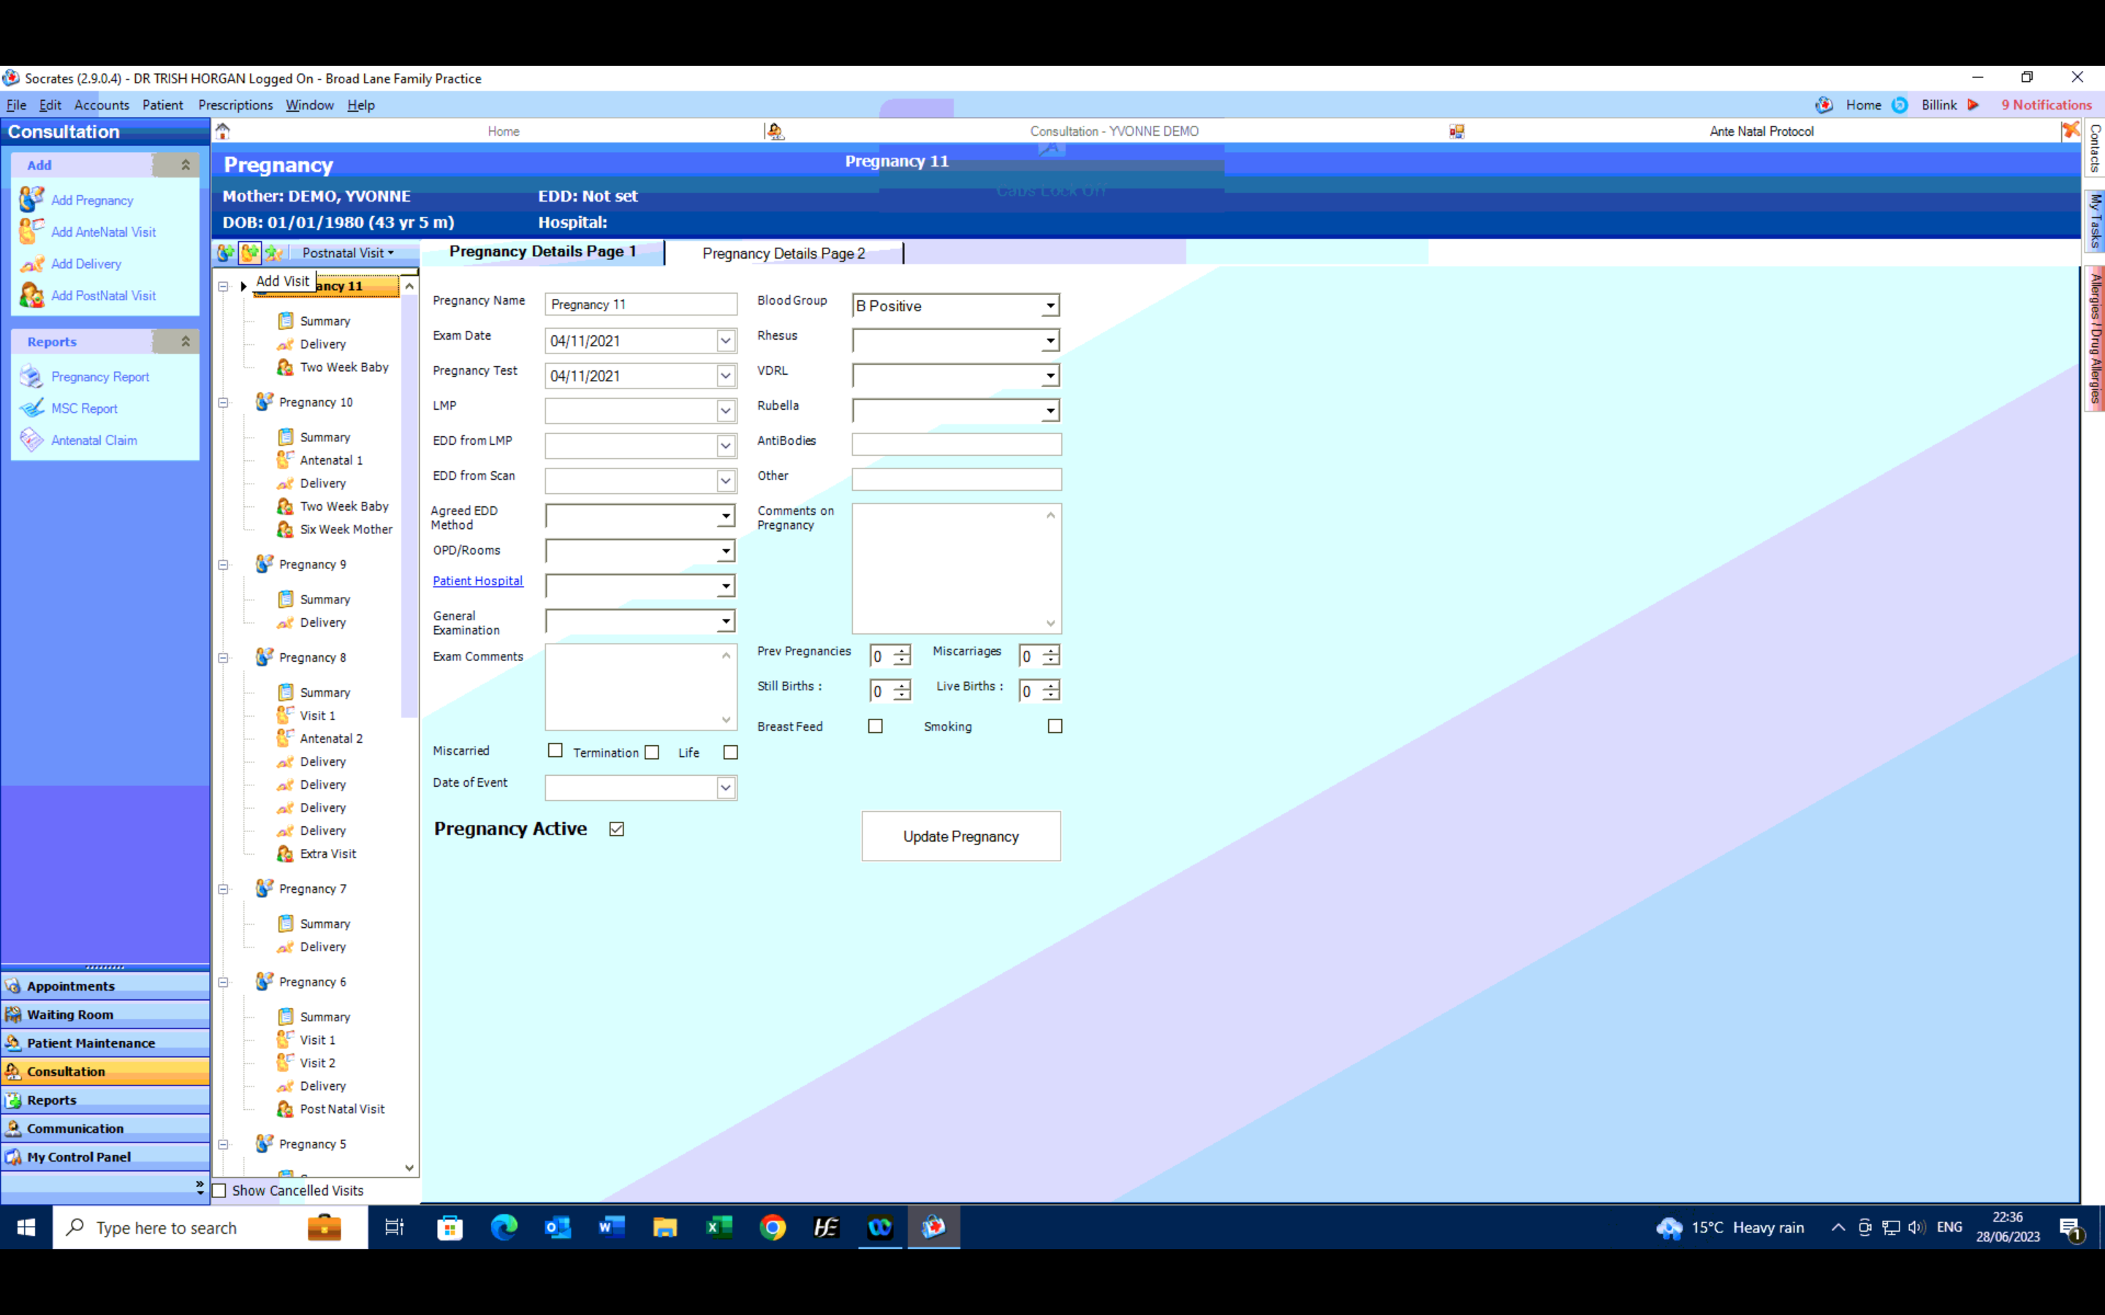

Slide 11
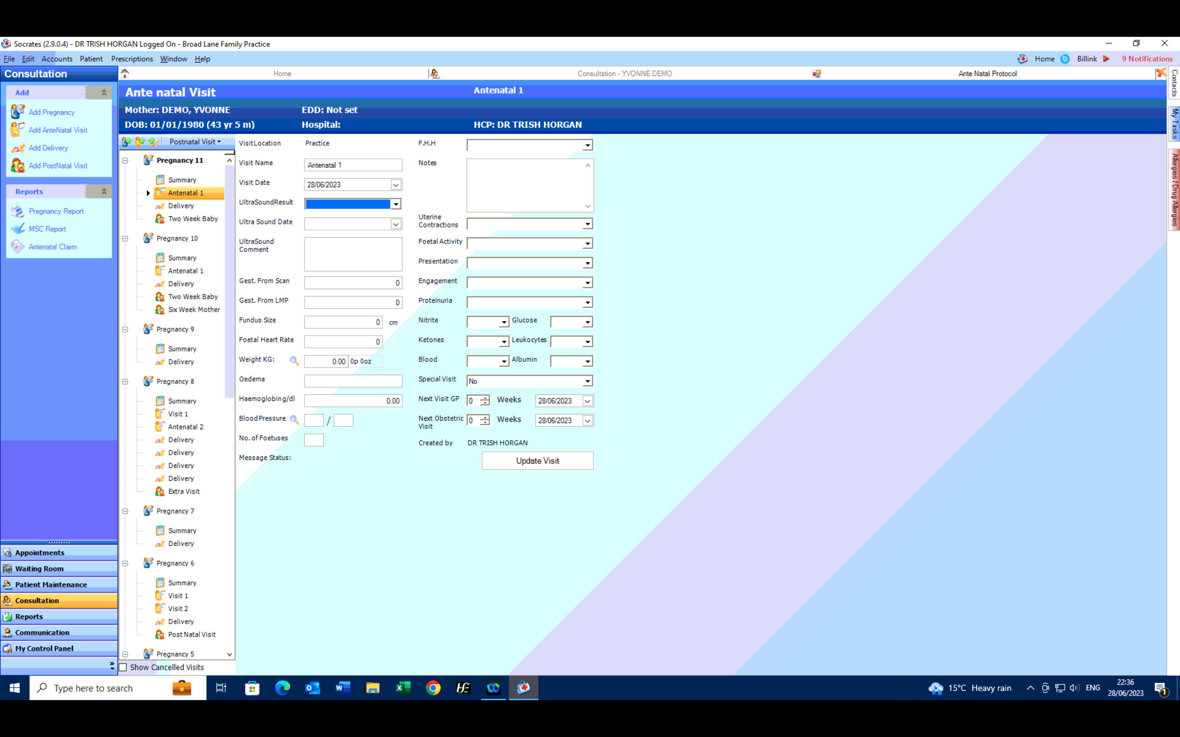

Slide 12
Post- partum routine check up
Ask about mood
Ask about bladder/bowel function
Ask about bleeding CAVE secondary PPH
Ask about sexual dysfunction
Offer contraception discussion

Slide 14
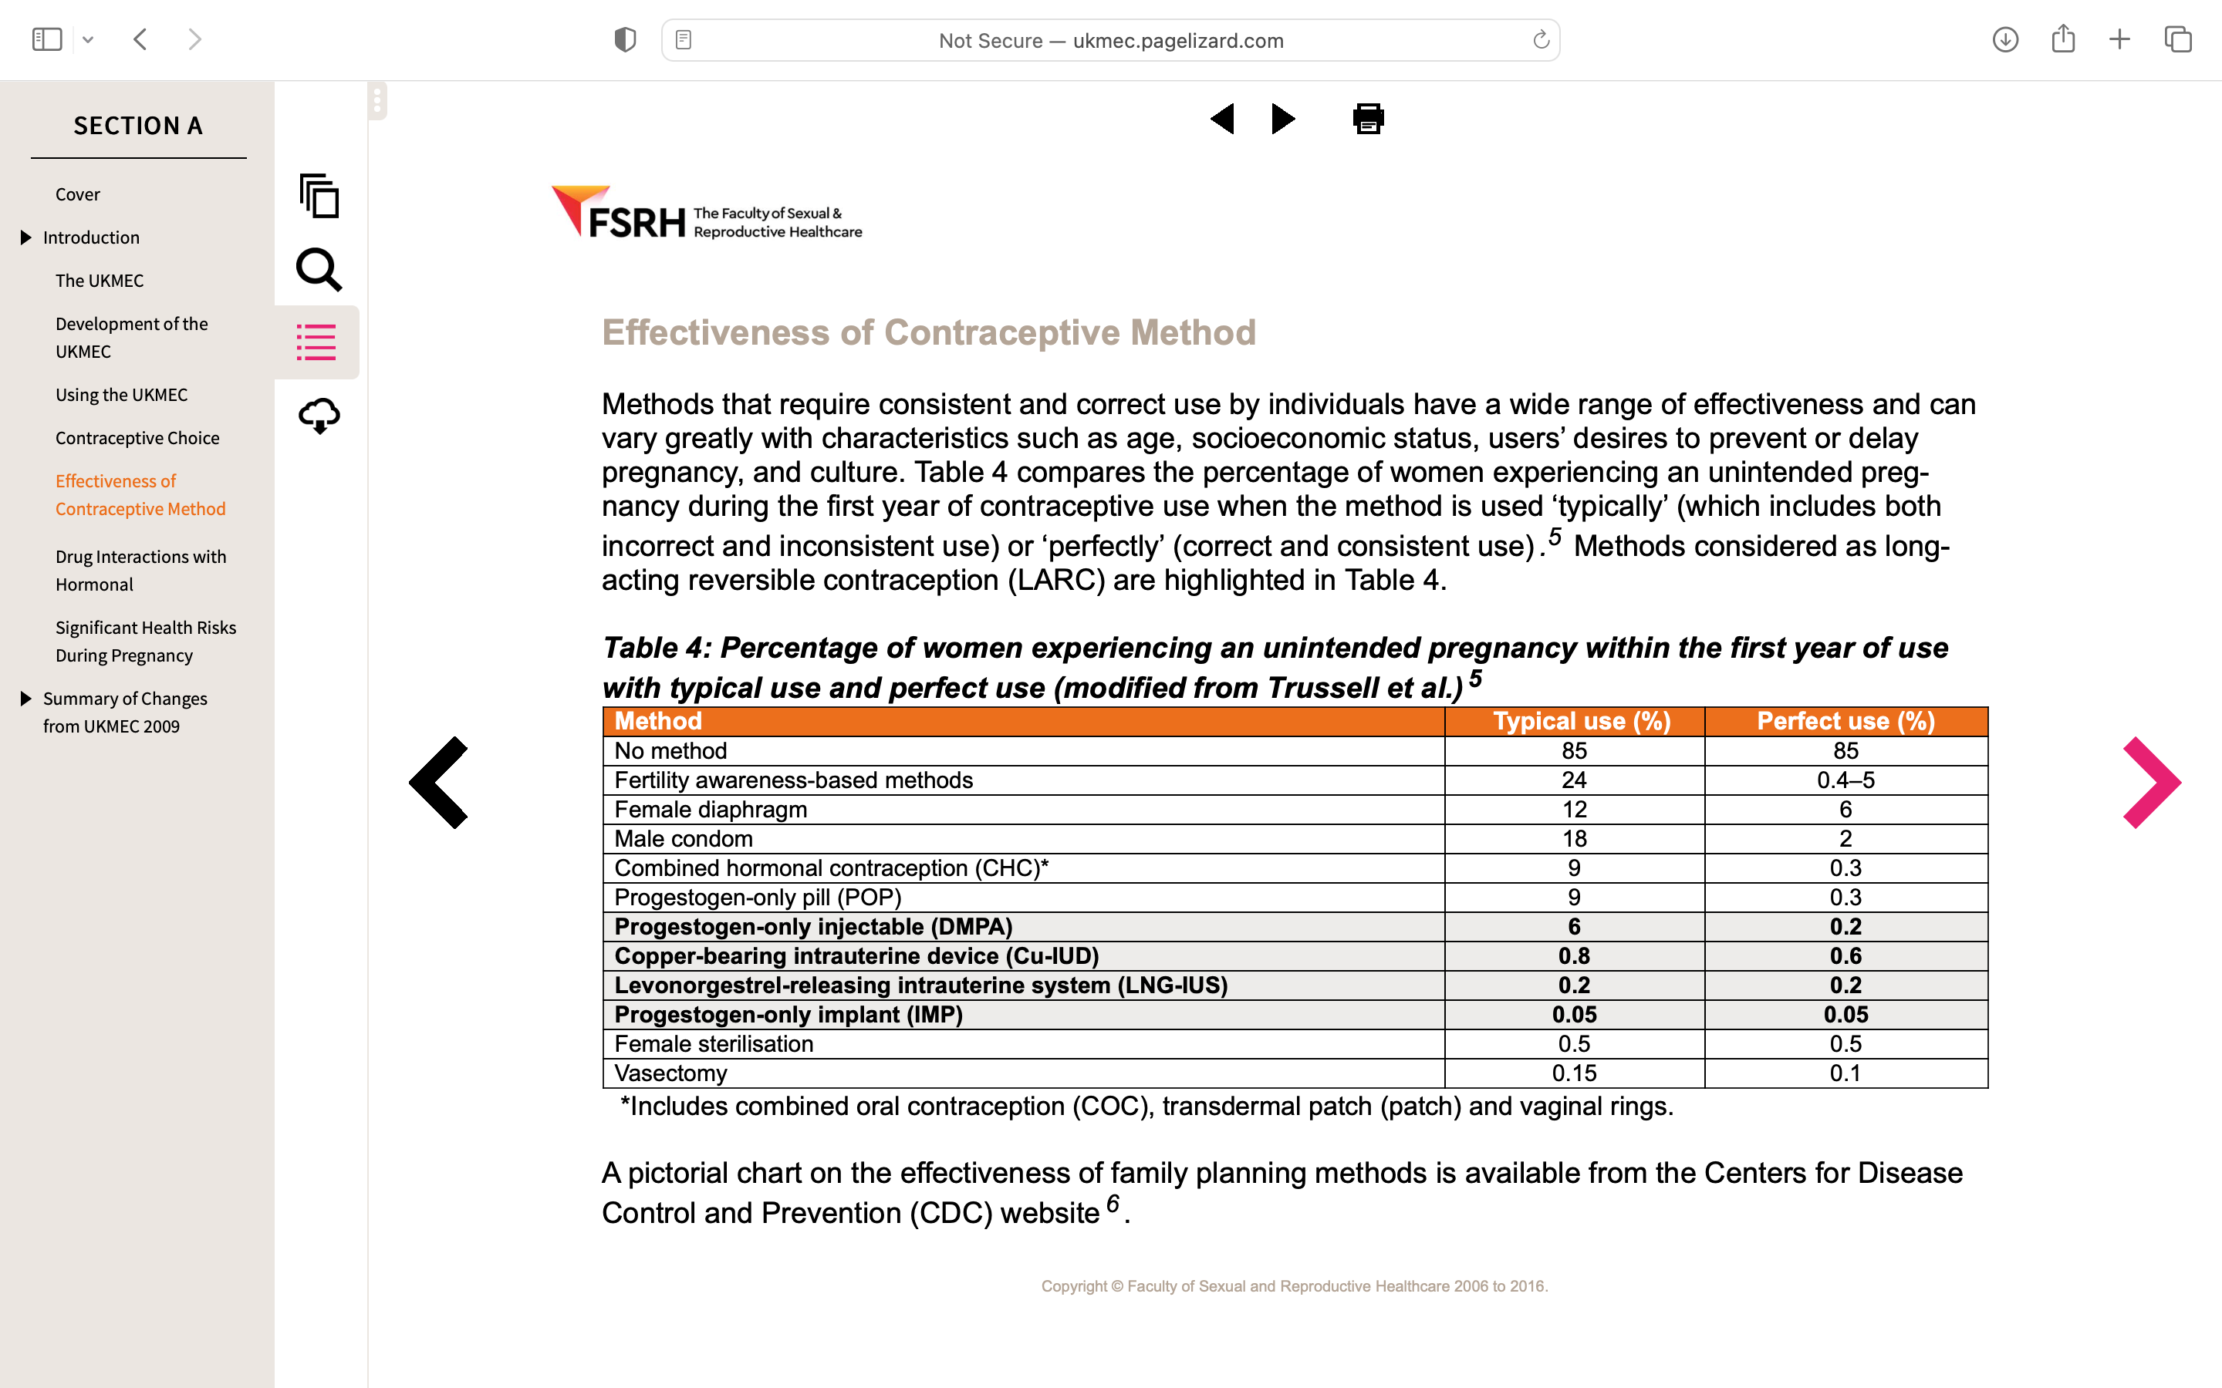

Slide 15
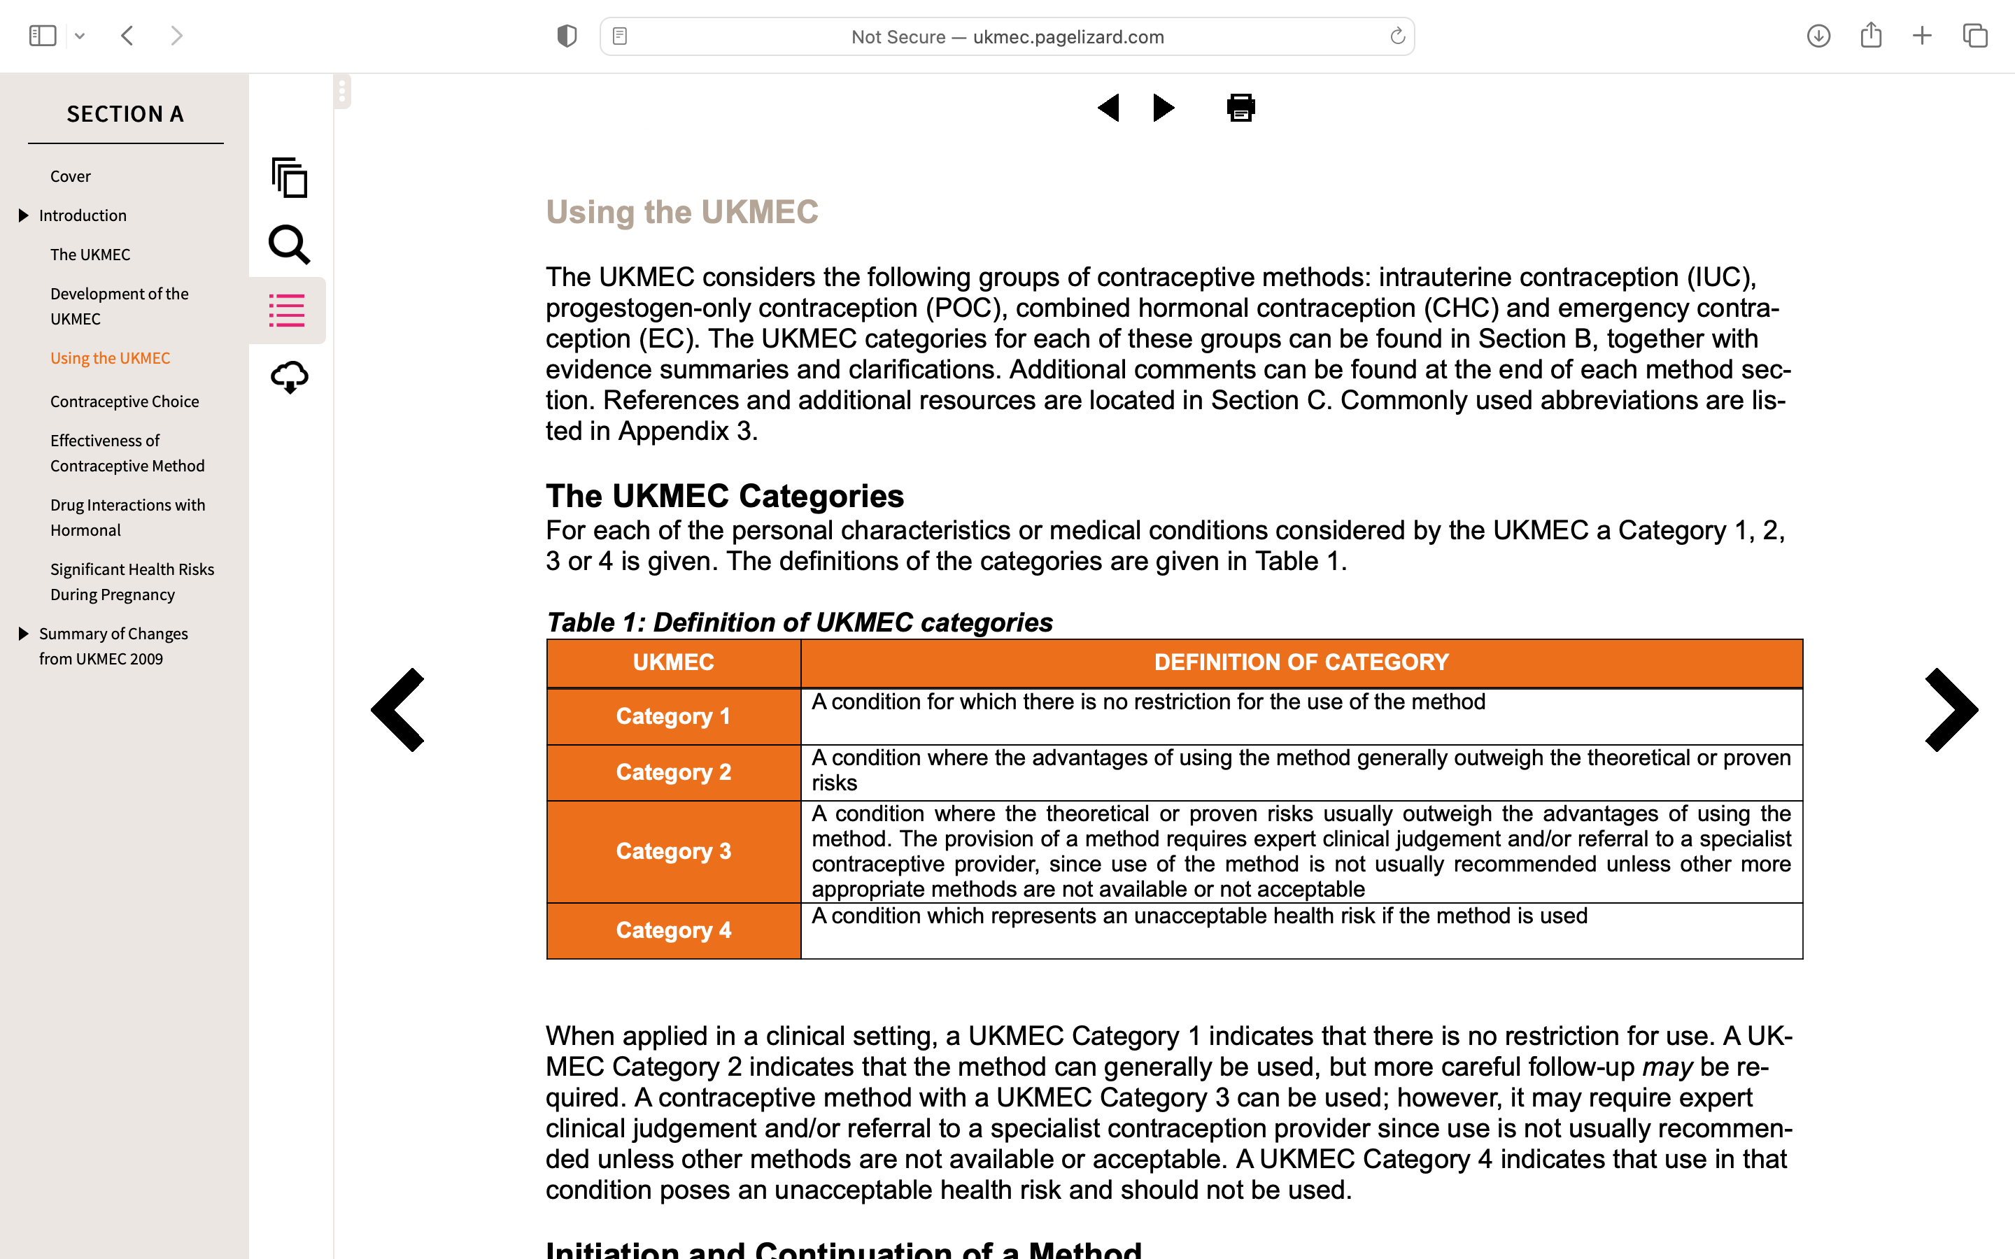

Slide 16
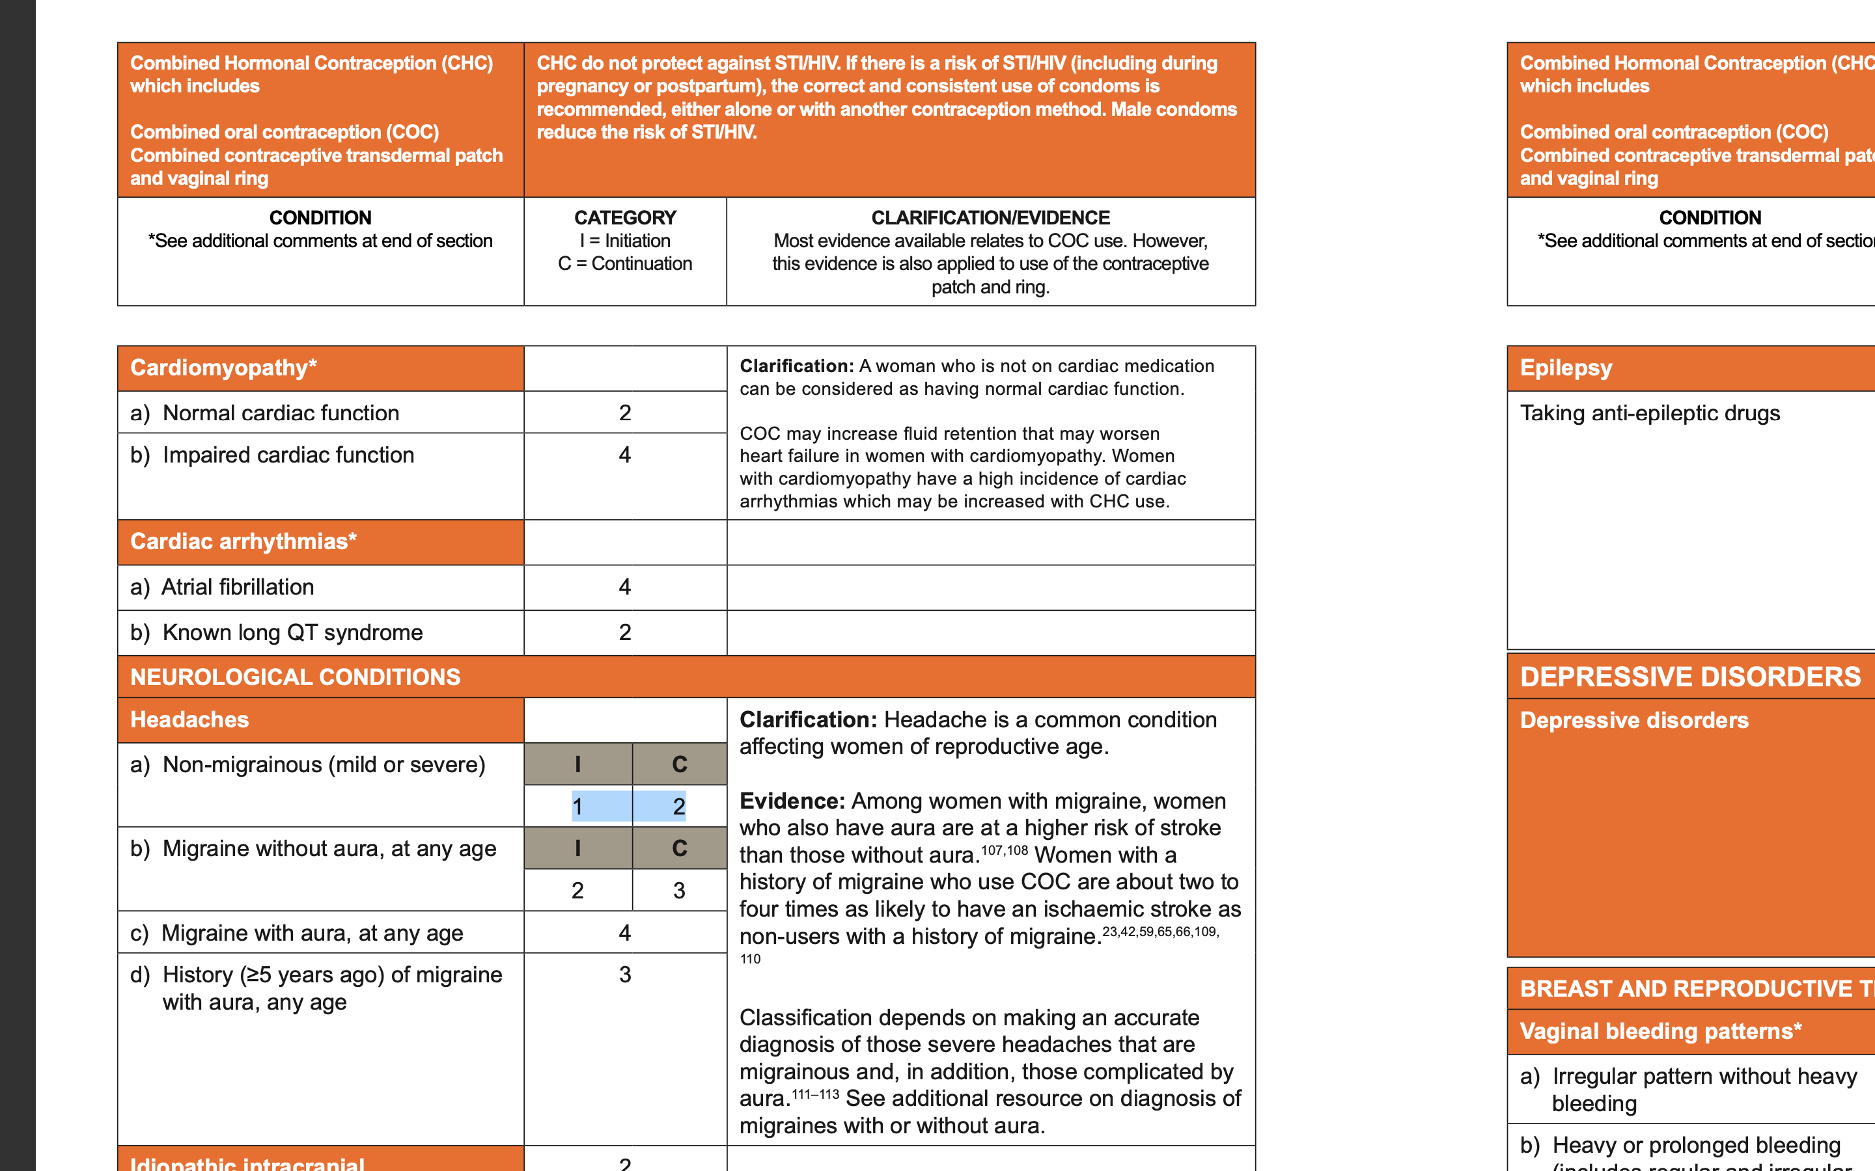

Slide 17
FREE CONTRACEPTION SCHEME
Sign Special Type Claim (STC) Form
All women aged 17-35years
Women age> 35 years with GMS (medical card)

Slide 18
As I’m here Doctor, can I just check;
Am I in the menopause?

Slide 19
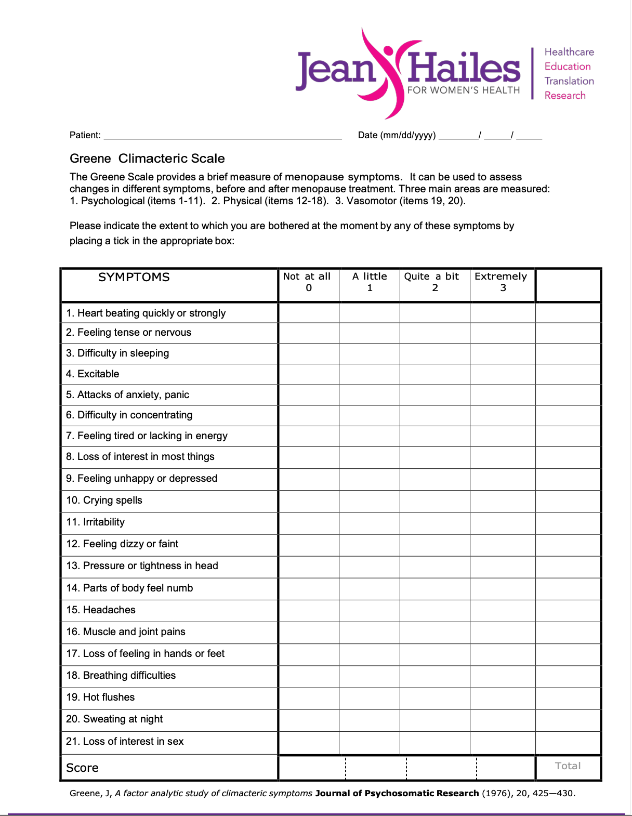

Slide 25
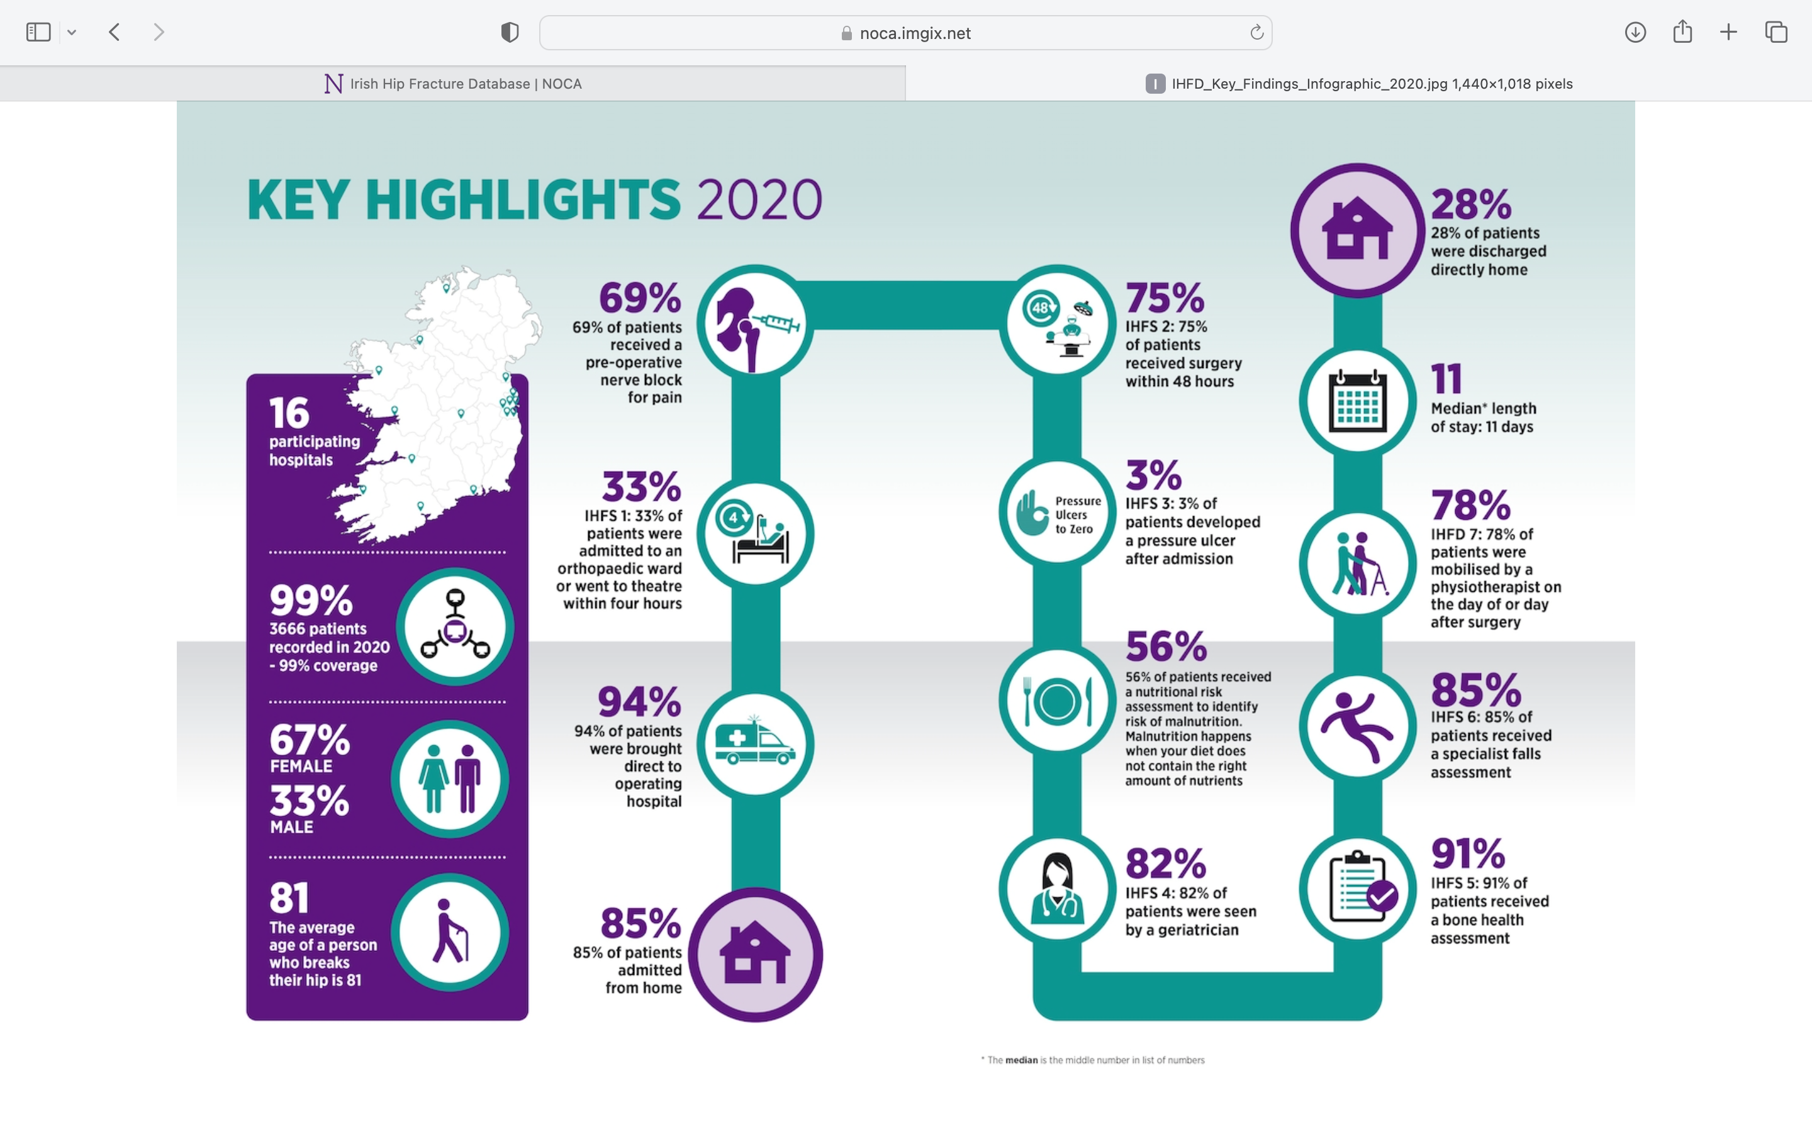
Irish Hip Fracture Data Base 2020

Slide 27
Infections- HSE antibiotic antibioticprescribing.ie

Slide 30
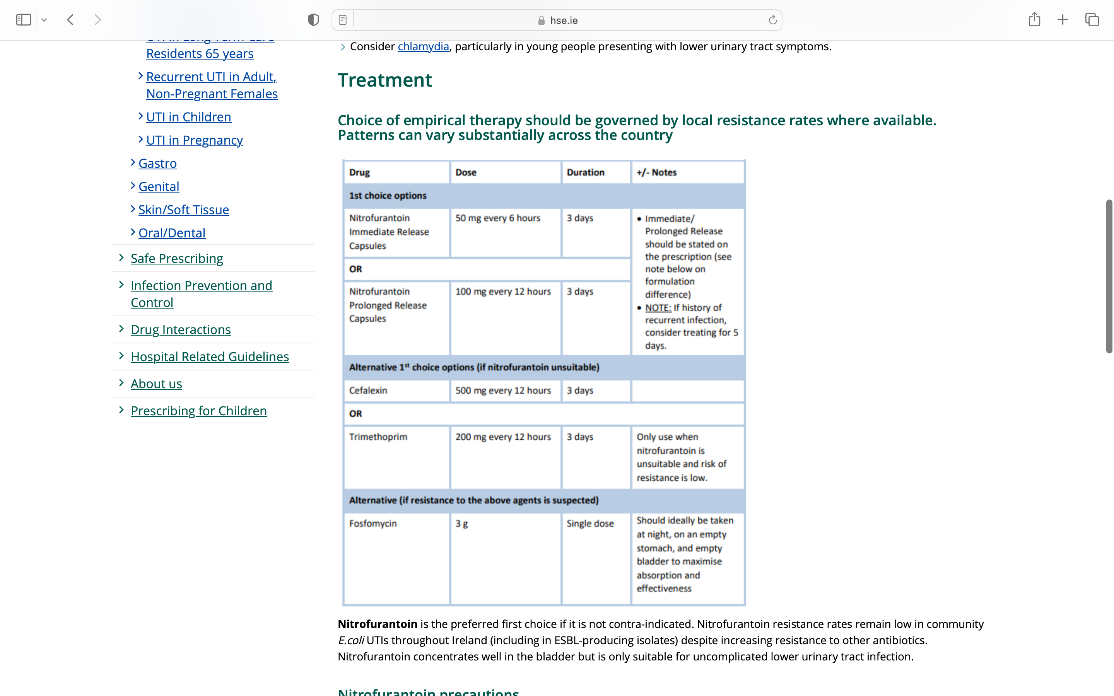

Slide 31
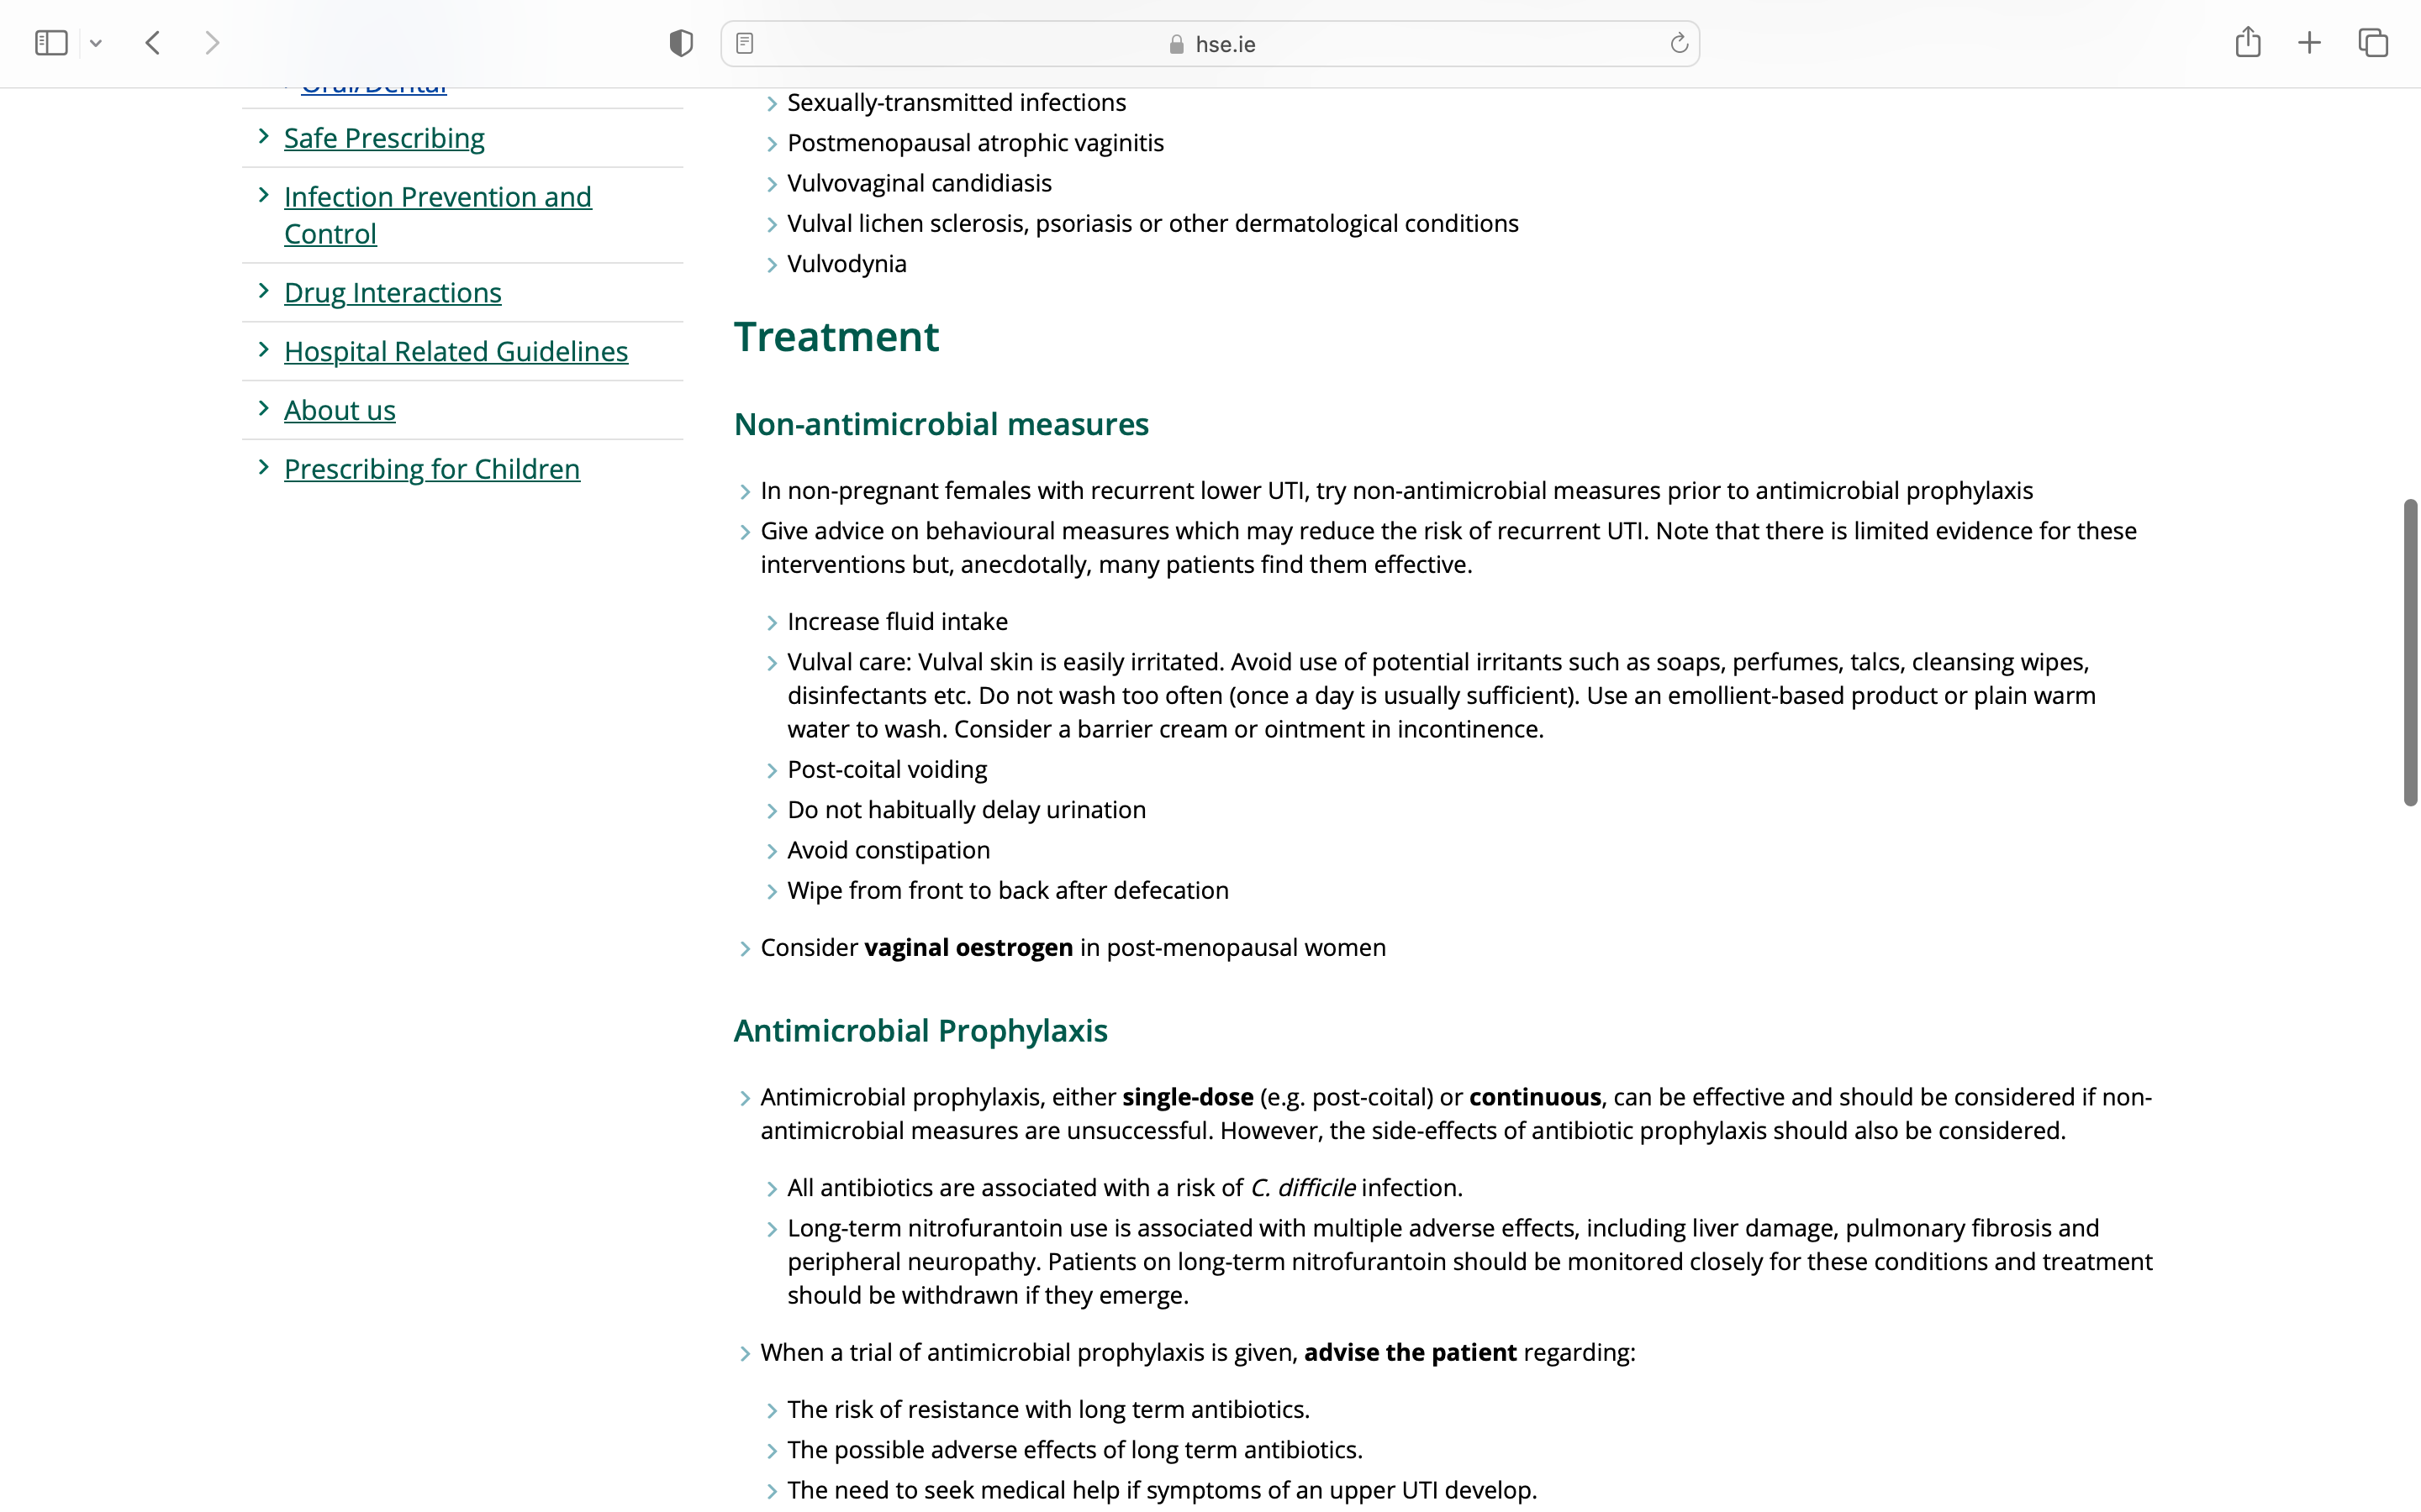

Slide 32
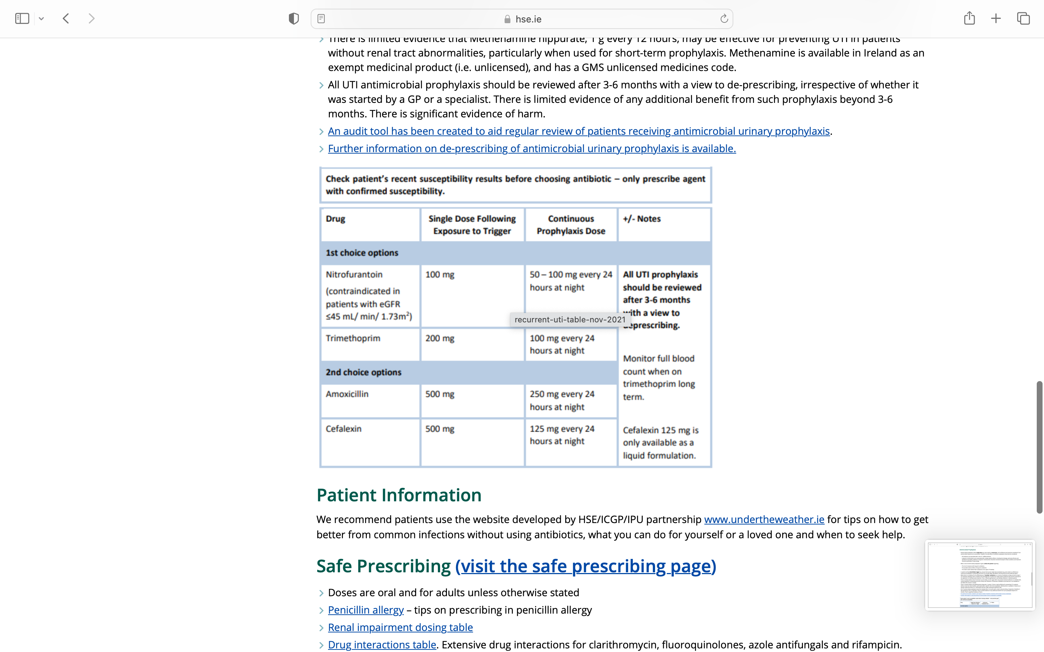

Slide 33
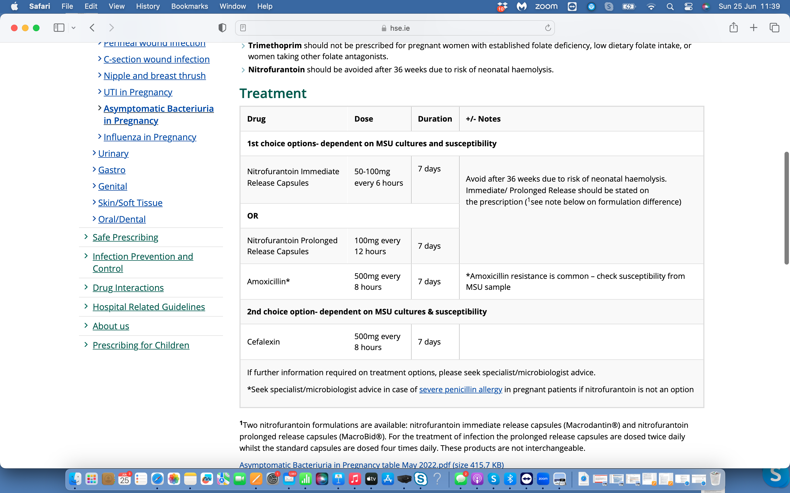

Slide 35
Vulval pain/soreness
“It’s the thrush again doctor”
ALWAYS EXAMINE
Sexually Active women- STI, genital herpes zoster, warts.
Older women- atrophic vaginitis, lichen planus, lichen sclerosis
Vulval ulceration in older women- red flag- r/o vulval neoplasm

Slide 36
Unscheduled bleeding
Post-menopasual- if > 1 year since last menses refer to r/o endometrial cancer
Sexually active- r/o STI- urine to lab for chlamydia, gonorrhoea, examine for local causes in vulva
All women- check cervix- cancer, polyp

Slide 37
Domestic Violence and Abuse
1 in 5 women who have been in relationship have been abused by a current or former partner
Annual Impact Report, Women’s Aid 2023. > 40K disclosures of abuse to women and children.
Pregnant women are 60% more likely to be subject to physical domestic violence and abuse than women who are not pregnant.
The most dangerous time for a victim of domestic violence is when she is on the verge of leaving, and for 6 months afterwards.
Women’s Aid National 24-hour freephone helpline- 1800341900

Slide 38
Take Home Messages
Always consider pregnancy
Contraception- FSRH- UKMEC. Sign STC form!
Pregnancy options and abortion- My Options Helpline
Reduced fetal movements is the chest pain of obstetrics
Infections- antibioticprescribing.ie
Vulval/vaginal problems & unscheduled bleeding- always examine.
Remember cardiovascular and bone health
Consider domestic violence and abuse

Slide 39
“Integrity is doing the right thing even when no-one is watching”
C.S Lewis

