Slide 1
CONGRATULATIONS Class of 2024.
Dr. Mike Thompson

Slide 2
Common paediatric presentations in General Practice.
Dr. Mike Thompson

Slide 3
Let them check you out for a minute whilst chatting to parent/s.
Observation crucial.
Get down to their level.
A toy / sticker etc helps.
A bit of banter if situation allows.
Explain what you would like to do in exam.
Develop a pattern – easy bits first, throat last!
Don’t get rattled by crying!
Support parents.
Safety net.
Under 16 – accompanied*.
Notes:
Age dependant

Slide 4
Anxiety.
ADHD.
ASD.
Allergies.
Child with chronic illness.
Child Protection issues.
Developmental Delay.
Parental anxiety.
URTI / LRTI.
PUO.
UTI.
Abdo pain.
Rashes.
Trauma.
Immunisations.
Baby check.
Asthma check.
“Cold” reviews.
Notes:
Your left – single item, straight forward, acute. Comfortable with this. Recognise sick child.
Middle – Routine care, Nurse led.
Your right - increasing complexity. Introduction

Slide 5
They are not mini adults: They have different types of thinking, less insight and are often upset or distressed.
Parents may often be worried/concerned. Parent is sometimes the patient!
Mostly, these consultations tend to be straightforward: usually single item consultation, often infectious.
Clusters:
Neonates / infant. Constipation, Feeding.
Catarrhal Child (2-4) Infections.
> 5yo: Trauma, abdominal pain.
Teenager Mental health.
Child with a chronic illness.
Knowing normal variants important: Use centile charts and check developmental milestones.
Notes:
Neonatal specific (feeding constipation)
Infants: Infectious phase (catarrhal child
>5 yo: Trauma, abdo pain etc

Slide 7
Development and Growth
Notes:
Picture: https://www.freepik.com/premium-vector/human-life-cycle-flat-illustration-male-female-growing-up-aging-men-women-different-ages-from-child-old-person-teenager-adult-baby-generation-aging-process_7505084.htm?epik=dj0yJnU9ZHg2NE9NbThVRkxzblVzVnVlaFlWRzlCaHVpb3RVV0cmcD0wJm49VUFhN2Uxbm44aUw0M0RnZFJqT1dvdyZ0PUFBQUFBR1JRSVJj

Slide 8
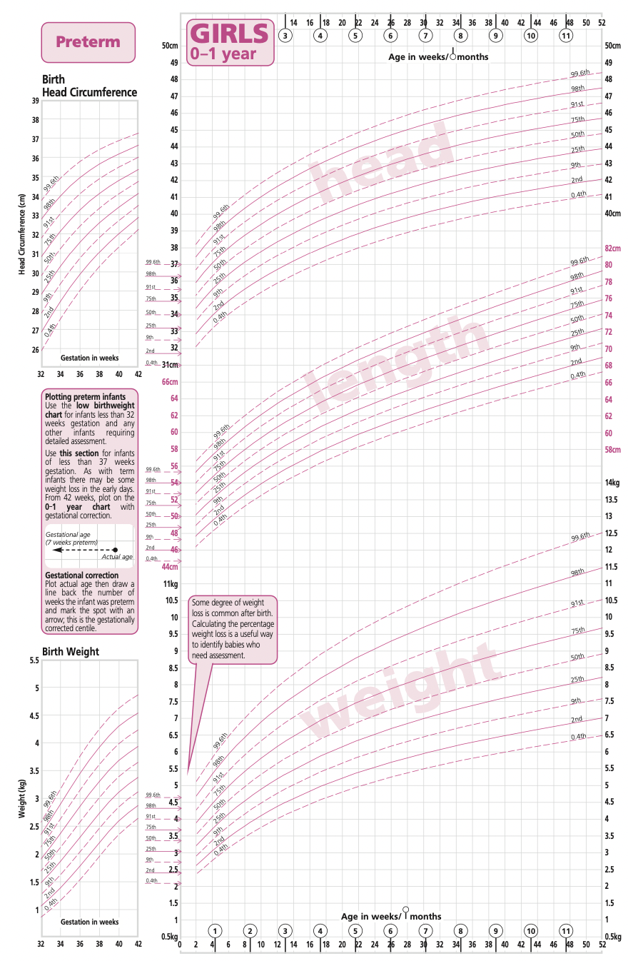
Growth
Heigth / weight /(OFC if infant).
On GP software.
Can be very reassuring to parents.
Failure to Thrive.
Fall across 1+ weight centile spaces if birth weight below 9th centile
Fall across 2+ weight centile spaces if birth weight between 9th-91st centiles
Fall across 3+ weight centile spaces if birth weight above 91st centile
Current weight below 2nd centile regardless of birth weight
Obesity: BMI greater ≥95th centile for age and gender in children 2+ years old
Diet, Exercise, Social status all play a role.
Don’t necessarily have to lose weight as they will have growth spurts, so aim for maintenance and diet education.
Centile charts: Age and Gender specific
Notes:
Missing milestones
Obesity : https://www.google.com/url?sa=t&rct=j&q=&esrc=s&source=web&cd=&cad=rja&uact=8&ved=2ahUKEwjjkLLPw8j-AhW8VaQEHXxtD0MQFnoECAoQAw&url=https%3A%2F%2Fwww.ncbi.nlm.nih.gov%2Fbooks%2FNBK570626%2F%23%3A~%3Atext%3DObesity%2520is%2520defined%2520as%2520having%2Cequal%2520to%2520the%2520120th%2520percentile.&usg=AOvVaw0cRV19Sr5LBktWOpDusv_x
Failure to thrive : https://www.olchc.ie/healthcare-professionals/clinical-guidelines/faltering-growth-infants-and-children-under-2-years.pdf

Slide 10
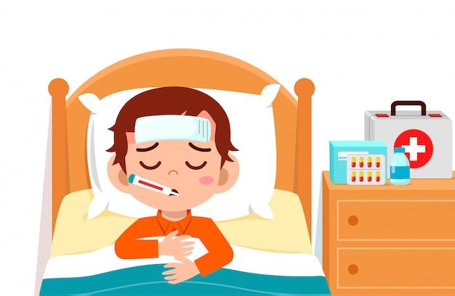
Illness in children
Notes:
Picture: https://www.freepik.com/premium-vector/sad-cute-kid-boy-lay-bed-sick_7506480.htm#query=sick%20kid&position=31&from_view=keyword&track=ais

Slide 11
What is a sick child?
Questions to ask:
Any temperature >38ºC?
Are they having more than 50% of wet nappies?
Any vomiting? Photophobia?
What have they tried so far?
Any recent vaccinations / contacts w illness.
During the appointment:
A: Airway
B: Breathing (RR, O2 saturations)
C: Circulation (HR, Capillary refill)
D: Disability (Glucose, AVPU)
E: Exposure (Temperature, Rash, …)
Management: Safety first!
Always review by senior colleague
Treatment
Review
Refer

Slide 12
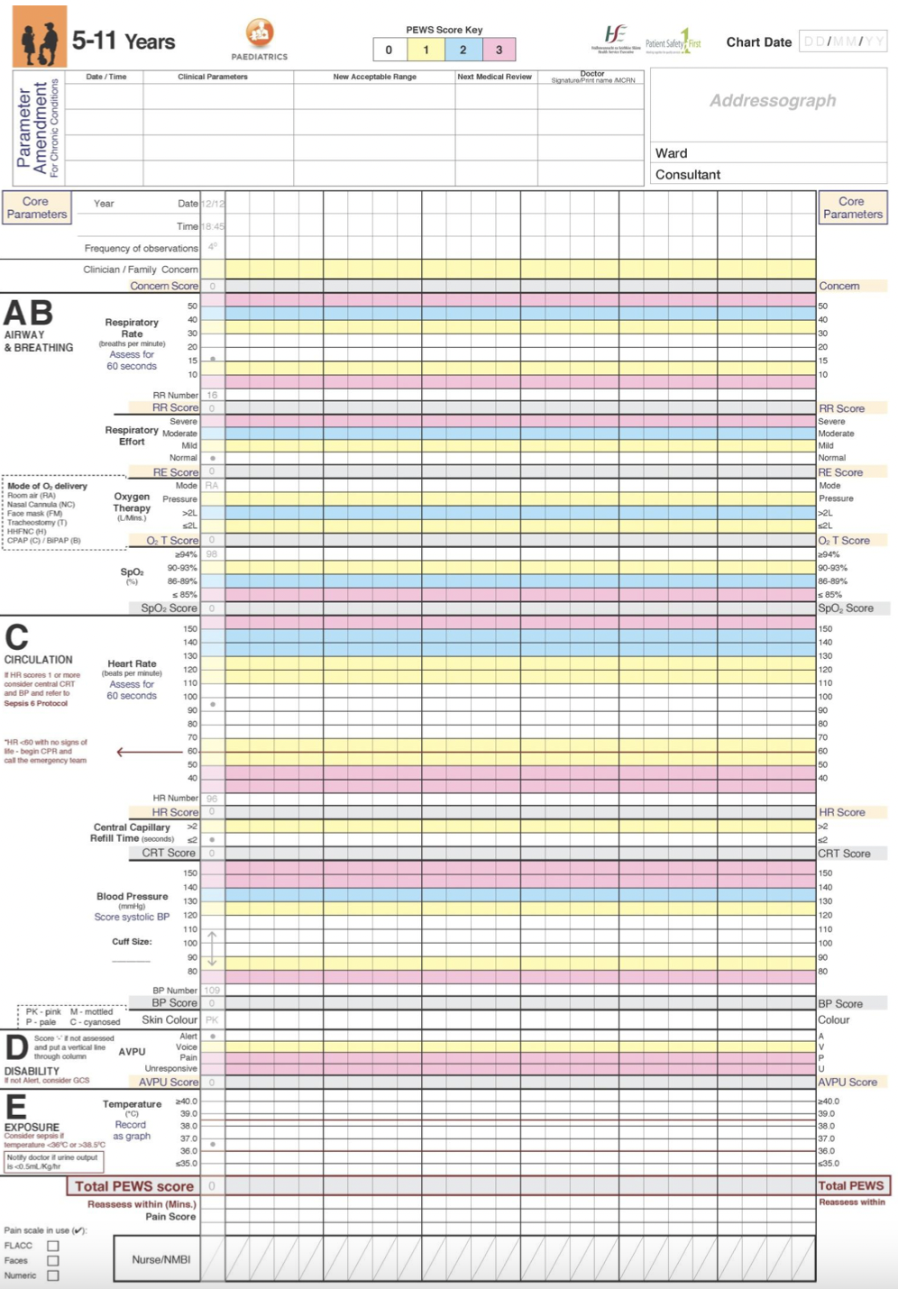
What is a sick child?
NICE guideline – High risk symptoms
All children:
Color: Pale, Cyanosis, Mottling
Lethargy, Not rousable
Respiratory: Grunting, Elevated RR, Accessory muscle use
Fever of unknown origin
Non blanching rash
Neck stiffness
Status epilepticus
Infants:
Pyrexia>38ºC and under 3 months old
Bulging of fontanelles
Weak or High-pitch continuous cry
Decreased wet nappies

Slide 14
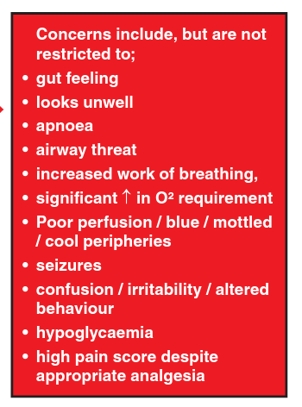

Slide 15
Common presentations.

Slide 16
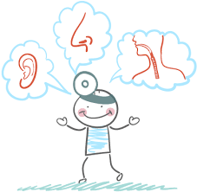
ENT presentations
Notes:
Picture: https://www.ent-sd.com/about-ent-medical-office-san-diego/

Slide 17
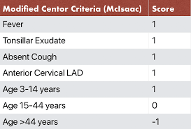
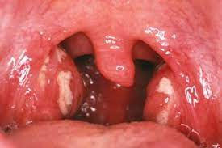
Tonsillitis
Tonsillitis – Use Centor Score to determine treatment, if > 2 years old
If score >3: Oral Antibiotics (eg. Amoxicillin; if recurrent check what worked last time)
Refer to ENT for Tonsillectomy if
> 3 in 3 years or > 5 in 2 years or >7 in 1 year
Quinsy: Unilateral sore throat, Pain on swallowing, Difficulty opening mouth and speaking, Earache, …
Sleep apnea
Rule out Glandular fever, in older children
Social history is important
Palpate for any splenomegaly
? Value of a tonsillar swab
Notes:
Picture tonsillitis –purulent. : https://www.google.com/imgres?imgurl=https%3A%2F%2Fassets.nhs.uk%2Fnhsuk-cms%2Fimages%2FM2700195-Tonsillitis-SPL.width-320.jpg&tbnid=8SIKwY-bVaMg2M&vet=12ahUKEwjv9r-dxsj-AhURTUEAHfT-A6AQMygEegUIARDYAQ..i&imgrefurl=https%3A%2F%2Fwww.nhs.uk%2Fconditions%2Ftonsillitis%2F&docid=-Ce9ZzHsGUVs6M&w=320&h=213&q=purulent%20tonsils&client=safari&ved=2ahUKEwjv9r-dxsj-AhURTUEAHfT-A6AQMygEegUIARDYAQ
Quinsy: https://www.nidirect.gov.uk/conditions/quinsy
A word about GABHS / iGAS.

Slide 18
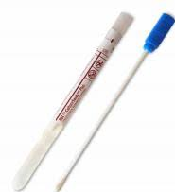
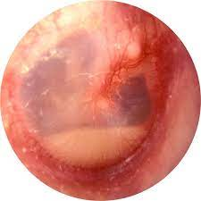
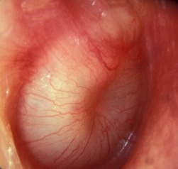
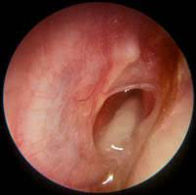
The Ear
Acute Otitis Media
Viral (often self-resolving) or Bacterial. Can be associated with tonsillitis
O/E: Fluid level or bubbles behind tympanic membrane
Tx: Analgesia (Calpol + Nurofen)
Antibiotics: If 2 ears affected, sign of systemic infection (eg. Pyrexia) or if < 2 years old
Can prescribe rescue antibiotics if no relief after 3 days
Complication of AOM:
Perforation of TM: Often associated with relief ± otorrhea
If frequent infections at young age, may have isolated speech delay
Refer to ENT or ED if:
Indication of Mastoiditis
Speech delay - grommets
When to Swab?
AOM not improving with treatment
Otitis externa
TM perforation with otorrhoea
Notes:
OM pain perf swab tx
AOM: https://www.hse.ie/eng/services/list/2/gp/antibiotic-prescribing/conditions-and-treatments/upper-respiratory/otitis-media/
OME pic: http://www.ensg.co.nz/hearing-loss-and-ear-disease/acute-otitis-media/
Bulging TM: https://www.danieltweedie.com/middle-ear-infections-in-children-acute-otitis-media
Perforation: https://www.rch.org.au/clinicalguide/guideline_index/Acute_otitis_media/
Swabs: https://www.ucsfbenioffchildrens.org/medical-tests/ear-drainage-culture
OE: https://www.pediatrics.wisc.edu/education/acute-otitis-media/exercises/images/
Tx: https://www.hse.ie/eng/services/list/2/gp/antibiotic-prescribing/conditions-and-treatments/eye-and-ear/acute-otitis-externa.html

Slide 19
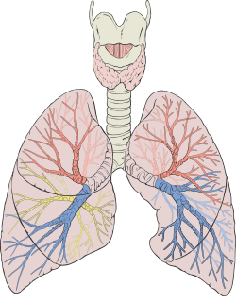
Respiratory presentations
Notes:
Picture: https://commons.wikimedia.org/wiki/File:Lungs_diagram_detailed.svg
Patrick J. Lynch, medical illustrator

Slide 20
Respiratory illness in a child
During every consult:
Check O2 saturation
Temperature
Listen to lung fields
Red flags:
O2 sats <92%
Pyrexia
Excessive work of breathing
Cyanosis

Slide 21
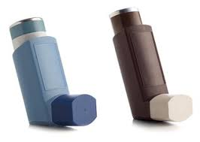
Asthma
Common first presentation symptoms
Uncontrolled cough and/or wheeze
Night-time cough
Exercised induced wheeze
Family history of Asthma
Personal history of Atopy (Eg. Eczema)
For diagnosis:
Child has to be > 3 years old .
?PFTs: Initially low, and Reversible with bronchodilators
Management: Refer to Nurse for Inhaler technique.
When to refer to specialist:
Failure to respond to treatment, recurrent exacerbations requiring hospital admissions. Diagnostic doubt.
1st step: SABA
2nd step: ICS (control) + SABA (rescue)
3rd step: ICS + LABA
4th step: ICS + LABA + Leukotriene antagonist – Might refer to specialist consultant
For acute exacerbation: Short course of Oral steroids can be used .
Notes:
Most kids with asthma never get an asthmatic attack
? Triggers

Slide 22
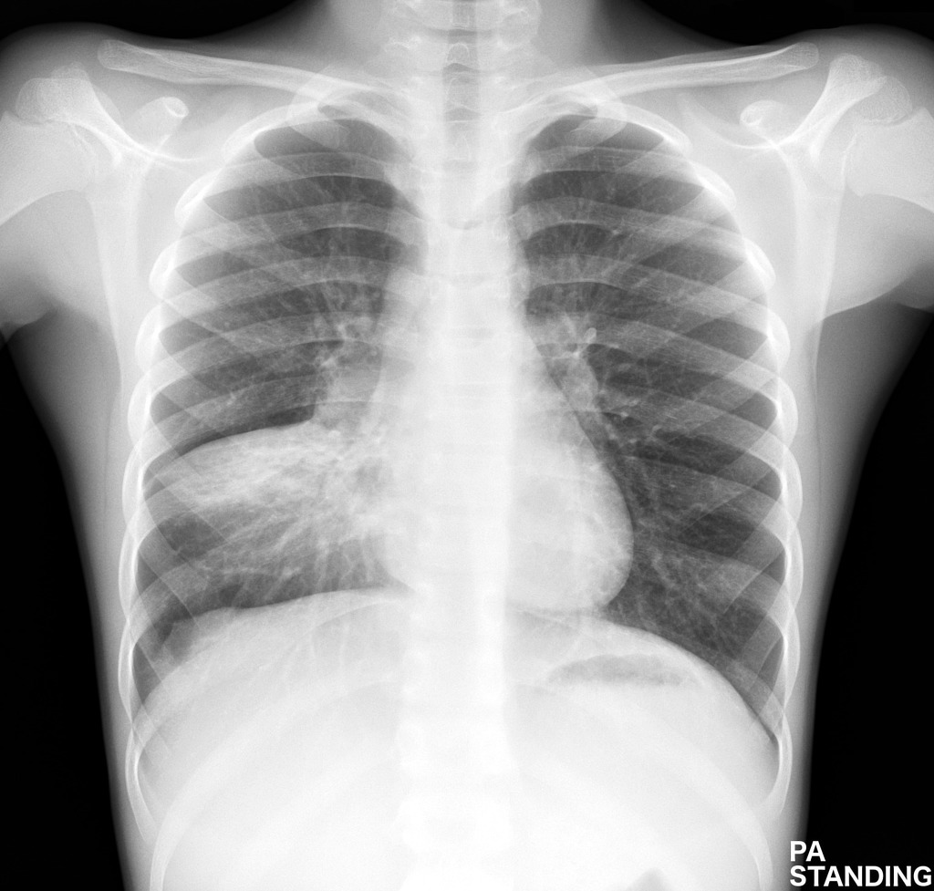
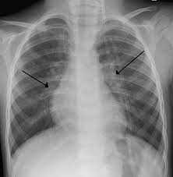
Common respiratory infections
Pneumonia
Pathogens: Bacteria or Viral
Symptoms:
Pyrexia > 38.5º
Cough
Chest &/or Abo pain
Increased work of breathing
Auscultation: Crepitations, Decreased breath sounds
Treatment:
Severe: Admit
Mild-moderate: Community management, with antibiotics.
Bronchiolitis
Pathogens: Most commonly due to RSV
Epidemiology: <1, up to 3 years old
Symptoms:
Coryzal symptoms ± Pyrexia
Cough
Respiratory distress ± difficulty eating
Auscultation:
Widespread crepitations ± High pitched wheeze
Tachypnoea and Tachycardia
Treatment:
Mild: Conservative tx (Calpol, Fluids, etc) and safety netting
Severe: Admit IF FLUID OR O2 NEED
Notes:
Video: https://www.youtube.com/watch?v=KQTEu1mpRY8
Pneumonia: Page 876 Oxford handbook of General practice
Bronchiolitis: Page 877 Oxford handbook of General practice
Pneumonia picture: https://radiopaedia.org/cases/childhood-pneumonia-1
Bronchiolitis picture: https://en.wikipedia.org/wiki/Bronchiolitis

Slide 23
Common respiratory conditions
Croup
Pathogen: Most common is Parainfluenza virus
Symptoms:
Barking cough – worse with crying
Inspiratory stridor
Pyrexia
Coryzal symptoms
Treatment:
Mild: Community management with conservative treatment (Calpol, steam)
Severe: Admit, Steroid nebulizers ?
Infectious exacerbation of asthma
Signs & Symptoms:
Tachypnoea and Tachycardia
Wheezing
Shortness of breath
Accessory muscle use
O2 sats <92% (severe)
Unable to feed (severe)
Cyanosis (severe)
Tx:
Mild: Nebulized salbutamol
Severe: Admit
Influenza-like illness
Symptoms: Non-specific
Runny nose
Fever, Calmmy
Headache
Aches and pains
Abdo pain
Treatement:
Conservative (Panadol± Nurofen, Rest …)
Notes:
Croup: page 927 Oxford Handbook of General Practice

Slide 24
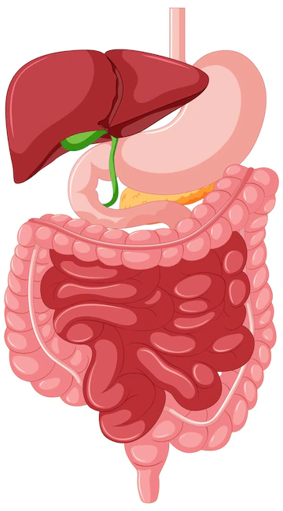
Gastrointestinal presentations
Notes:
Picture: https://www.freepik.com/free-vector/gastrointestinal-tract-anatomy-education_24093235.htm#query=gastrointestinal%20tract&position=0&from_view=keyword&track=robertav1_2_sidr

Slide 25
Abdominal pain
Most common causes of abdominal pain
Gastritis or Gastroenteritis: Self-limiting within 24-48h
Constipation
Mesenteric adenitis
Psychological: Stress or Anxiety
In teenage females: O+G
Red flags for abdominal pain
Bilious vomiting
Bloody stools or Diarrhoea
Night-time waking with pain
Prolonged vomiting: Risk dehydration/Hypoglycaemia
Trauma.
R/O Appendicitis:
McBurney’s point radiating to Umbilicus
Fever + chills
R/O Referred pain from UTI
Urine dipstick
R/O Testicular torsion
Always check below the belt

Slide 27
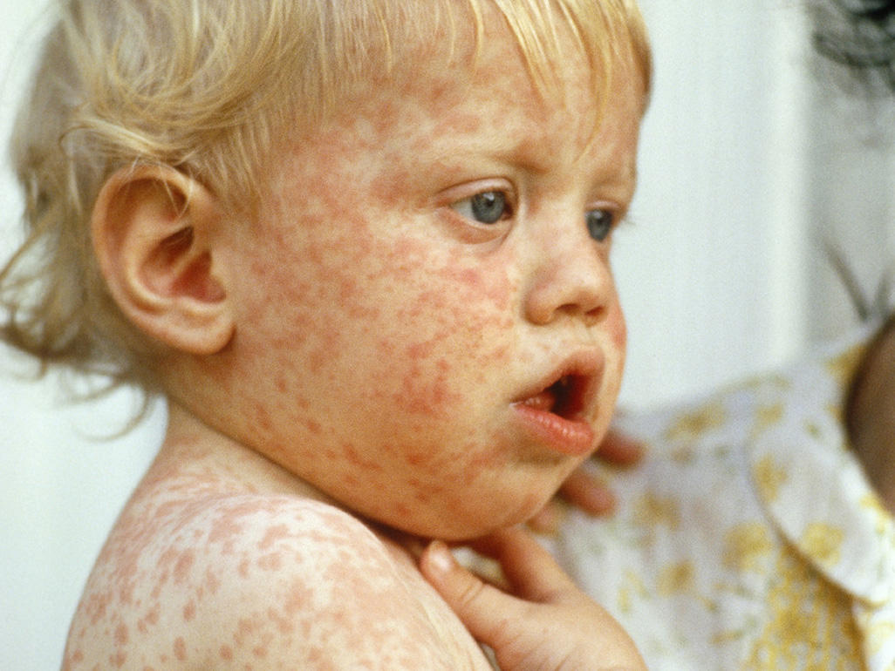
Dermatology
Notes:
Picture: https://www.babycentre.co.uk/l1038755/childhood-rashes-skin-conditions-and-infections-photos

Slide 28
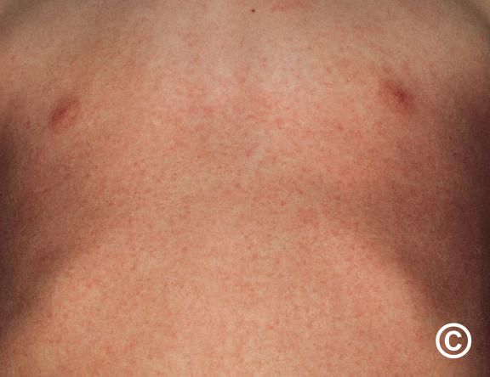
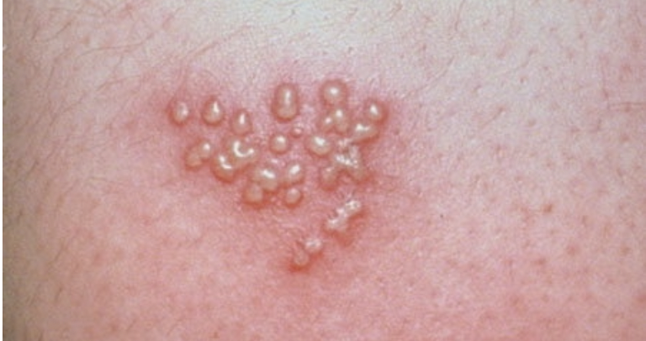
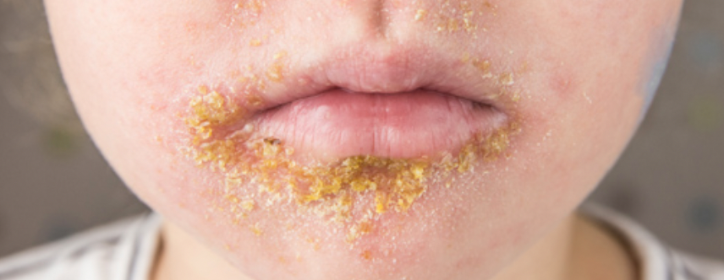
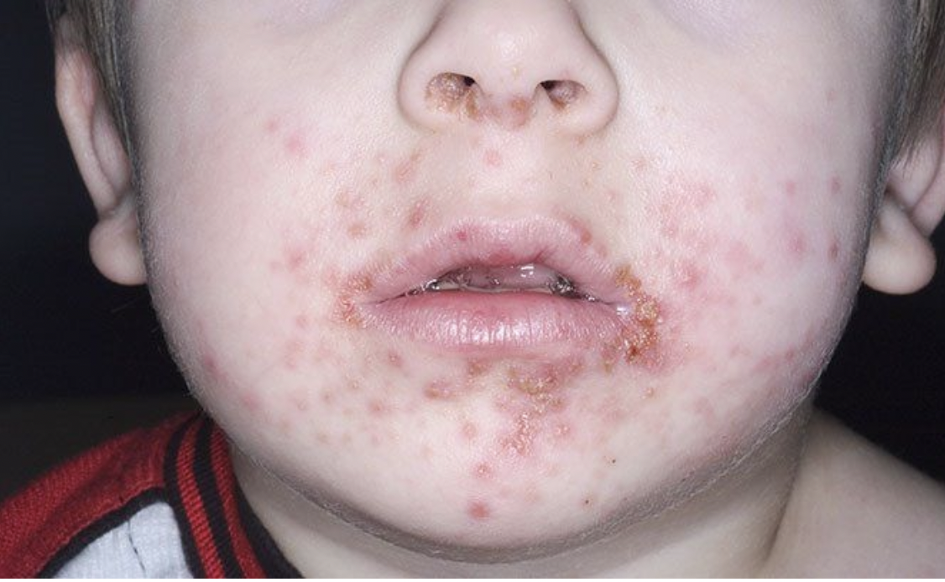
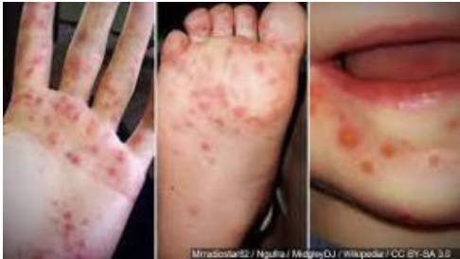
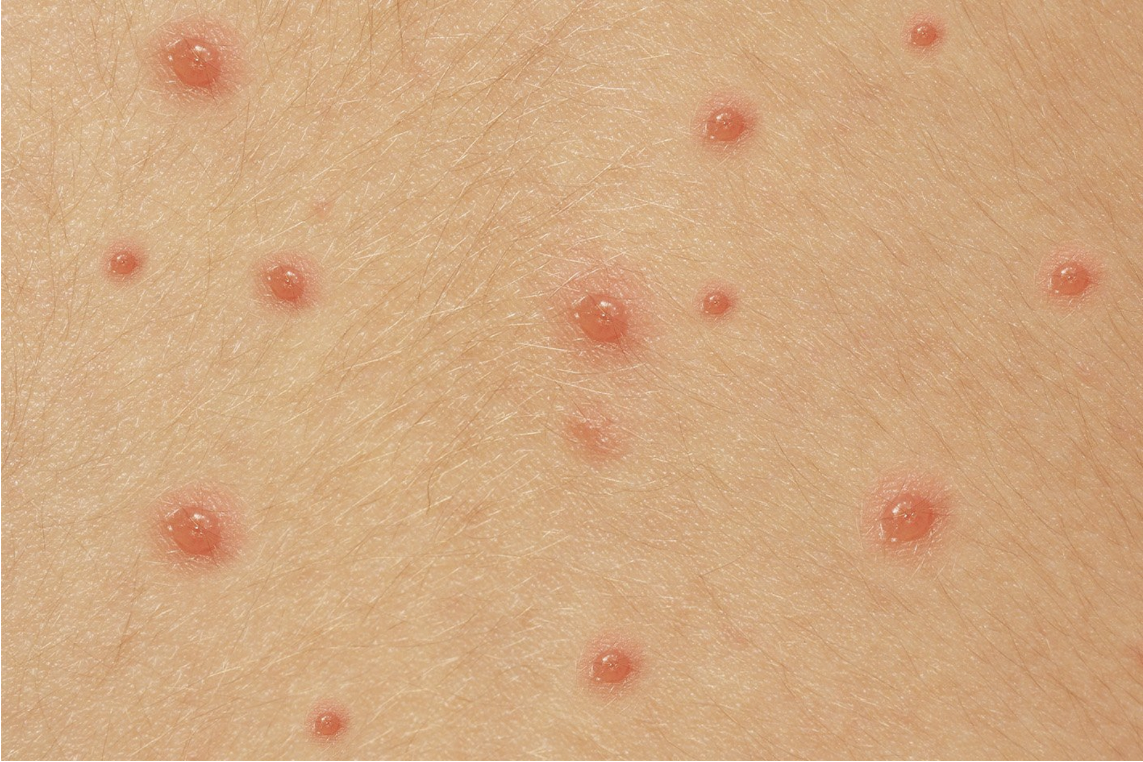
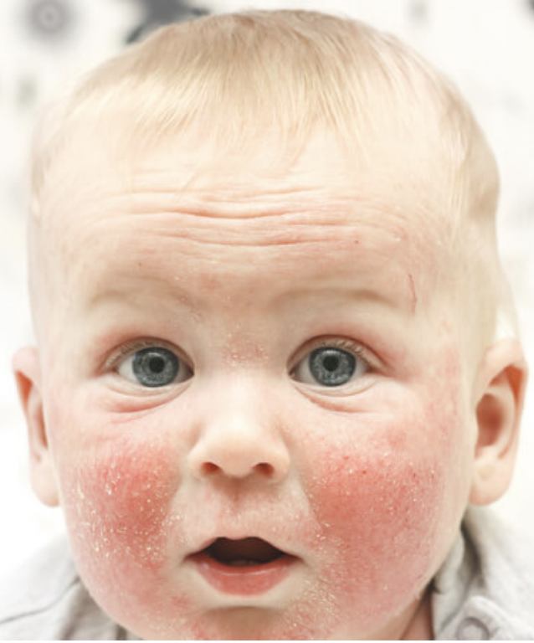
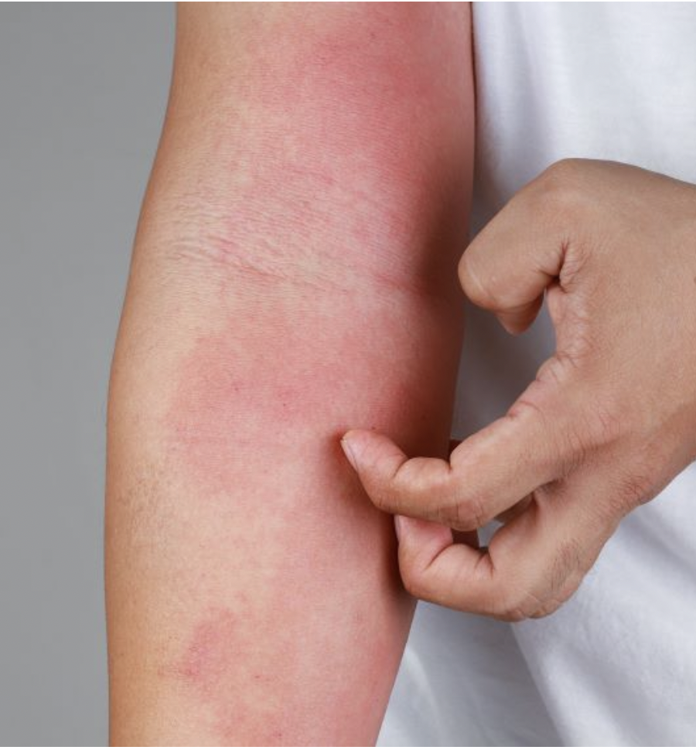
Common Rashes
Notes:
Cellulitis:
Picture: gpintern.com

Slide 29
Common Rashes
Scarletina - Group A streptococcus
Herpes Simplex
Impetigo – Staph aureus
Hand-Foot-Mouth - Coxsackie Virus
Chicken pox - VZV
Eczema
Notes:
Cellulitis:
Picture: gpintern.com

Slide 30
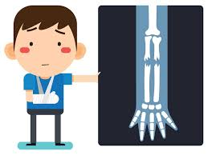
Orthopedics and Trauma
Notes:
Picture: https://www.injuredcalltoday.com/category/orthopedic-doctor-near-me/page/3/

Slide 31
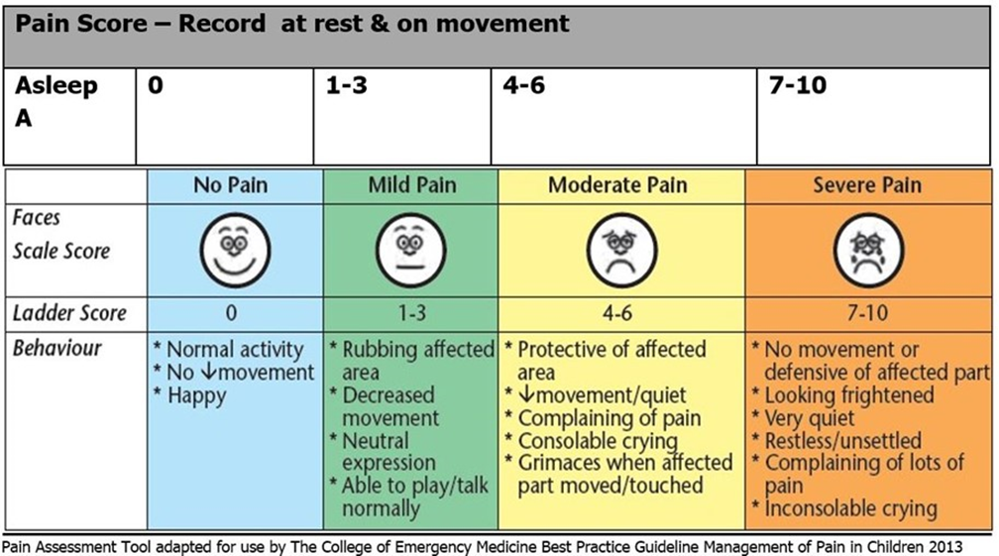

Slide 32
Orthopedics
Limping child
Causes:
Trauma
Developmental dysplasia of hip – Young child
Transient synovitis – Hx of infection?
Slipped upper Femoral Epiphysis
Perthe’s disease
Malignancy
Management:
Xray
Referral
± Physiotherapy
Pulled Elbow
Symptoms:
Refusal or inability to move injured eye
Holding arm still by their side
Pain
Management:
Analgesia
Reduction of partial radial dislocation
If not reducible: Refer to ED for Xray to R/O fracture
Greenstick fractures
Presentation: often <10 years old
Symptoms:
Bruising
Pain
Swelling
Not weight-bearing
Management:
Analgesia
Refer to ED: Xray ± reduction ± casting/splinting
Notes:
Pulled Elbow: https://www.rch.org.au/kidsinfo/fact_sheets/Pulled_elbow/
Greenstick fracture: https://www.mayoclinic.org/diseases-conditions/greenstick-fractures/diagnosis-treatment/drc-20351965
Septic Arthritis: https://orthopaedia.com/page/Septic-Arthritis-2

Slide 33
Trauma
Head trauma
Refer to A&E if:
Loss of consciousness
Vomiting x 2
Headache
Amnesia
Seizure
Signif MOI
Management:
If minor: Rest, Ice pack on injured area, Close monitoring, Analgesia
Advise to avoid contact sports for at least 3 weeks
Non-Accidental Injuries
Any grounds for concern, talk to the GP in your practice
Grounds for concern include:
Physical: bruises, fractures, burns,…
Neglect
Emotional abuse
Sexual abuse
Reporting to TUSLA with your GP
Notes:
Picture Burns: https://www.rch.org.au/clinicalguide/guideline_index/Burns/
Picture steristrips: https://www.nexcare.com/3M/en_US/nexcare/products/catalog/~/Nexcare-Steri-Strip-Wound-Closure/?N=4326+3294529207+3294631539&rt=rud
Concussion: https://www2.hse.ie/conditions/head-injury-concussion/
Concussion picture: https://www.chop.edu/conditions-diseases/concussion/health-resources

Slide 34
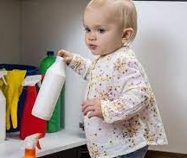
Poisoning
What did they ingest?
Tell Parents to bring the bottle in with them!
When did they ingest it?
How much did they ingest?
How are they doing now: Fever, Vomiting, Pain ?
If older child: was it intentional?
If unconscious, in respiratory distress, or for drugs with delayed onset: Admit!
You can use:
Toxbase.org
Poisons.ie – 24h service for healthcare professionals 018092566
Notes:
Please bring in whatever they took
Home advice, GP or ED for review

Slide 35
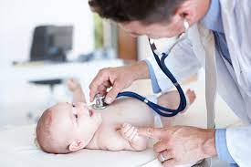
Neonatal presentations
Present at 2 and 6 weeks for Baby checks, often done by the nurse in practice.
Jaundice.
Sticky eyes.
Oral candida.
Rashes.
Feeding issues.
Constipation.
Reflux.
Mum?....
Notes:
Picture: https://www.pampers.co.uk/newborn-baby/development/article/well-baby-visits-visiting-your-doctor-and-what-to-expect

Slide 36
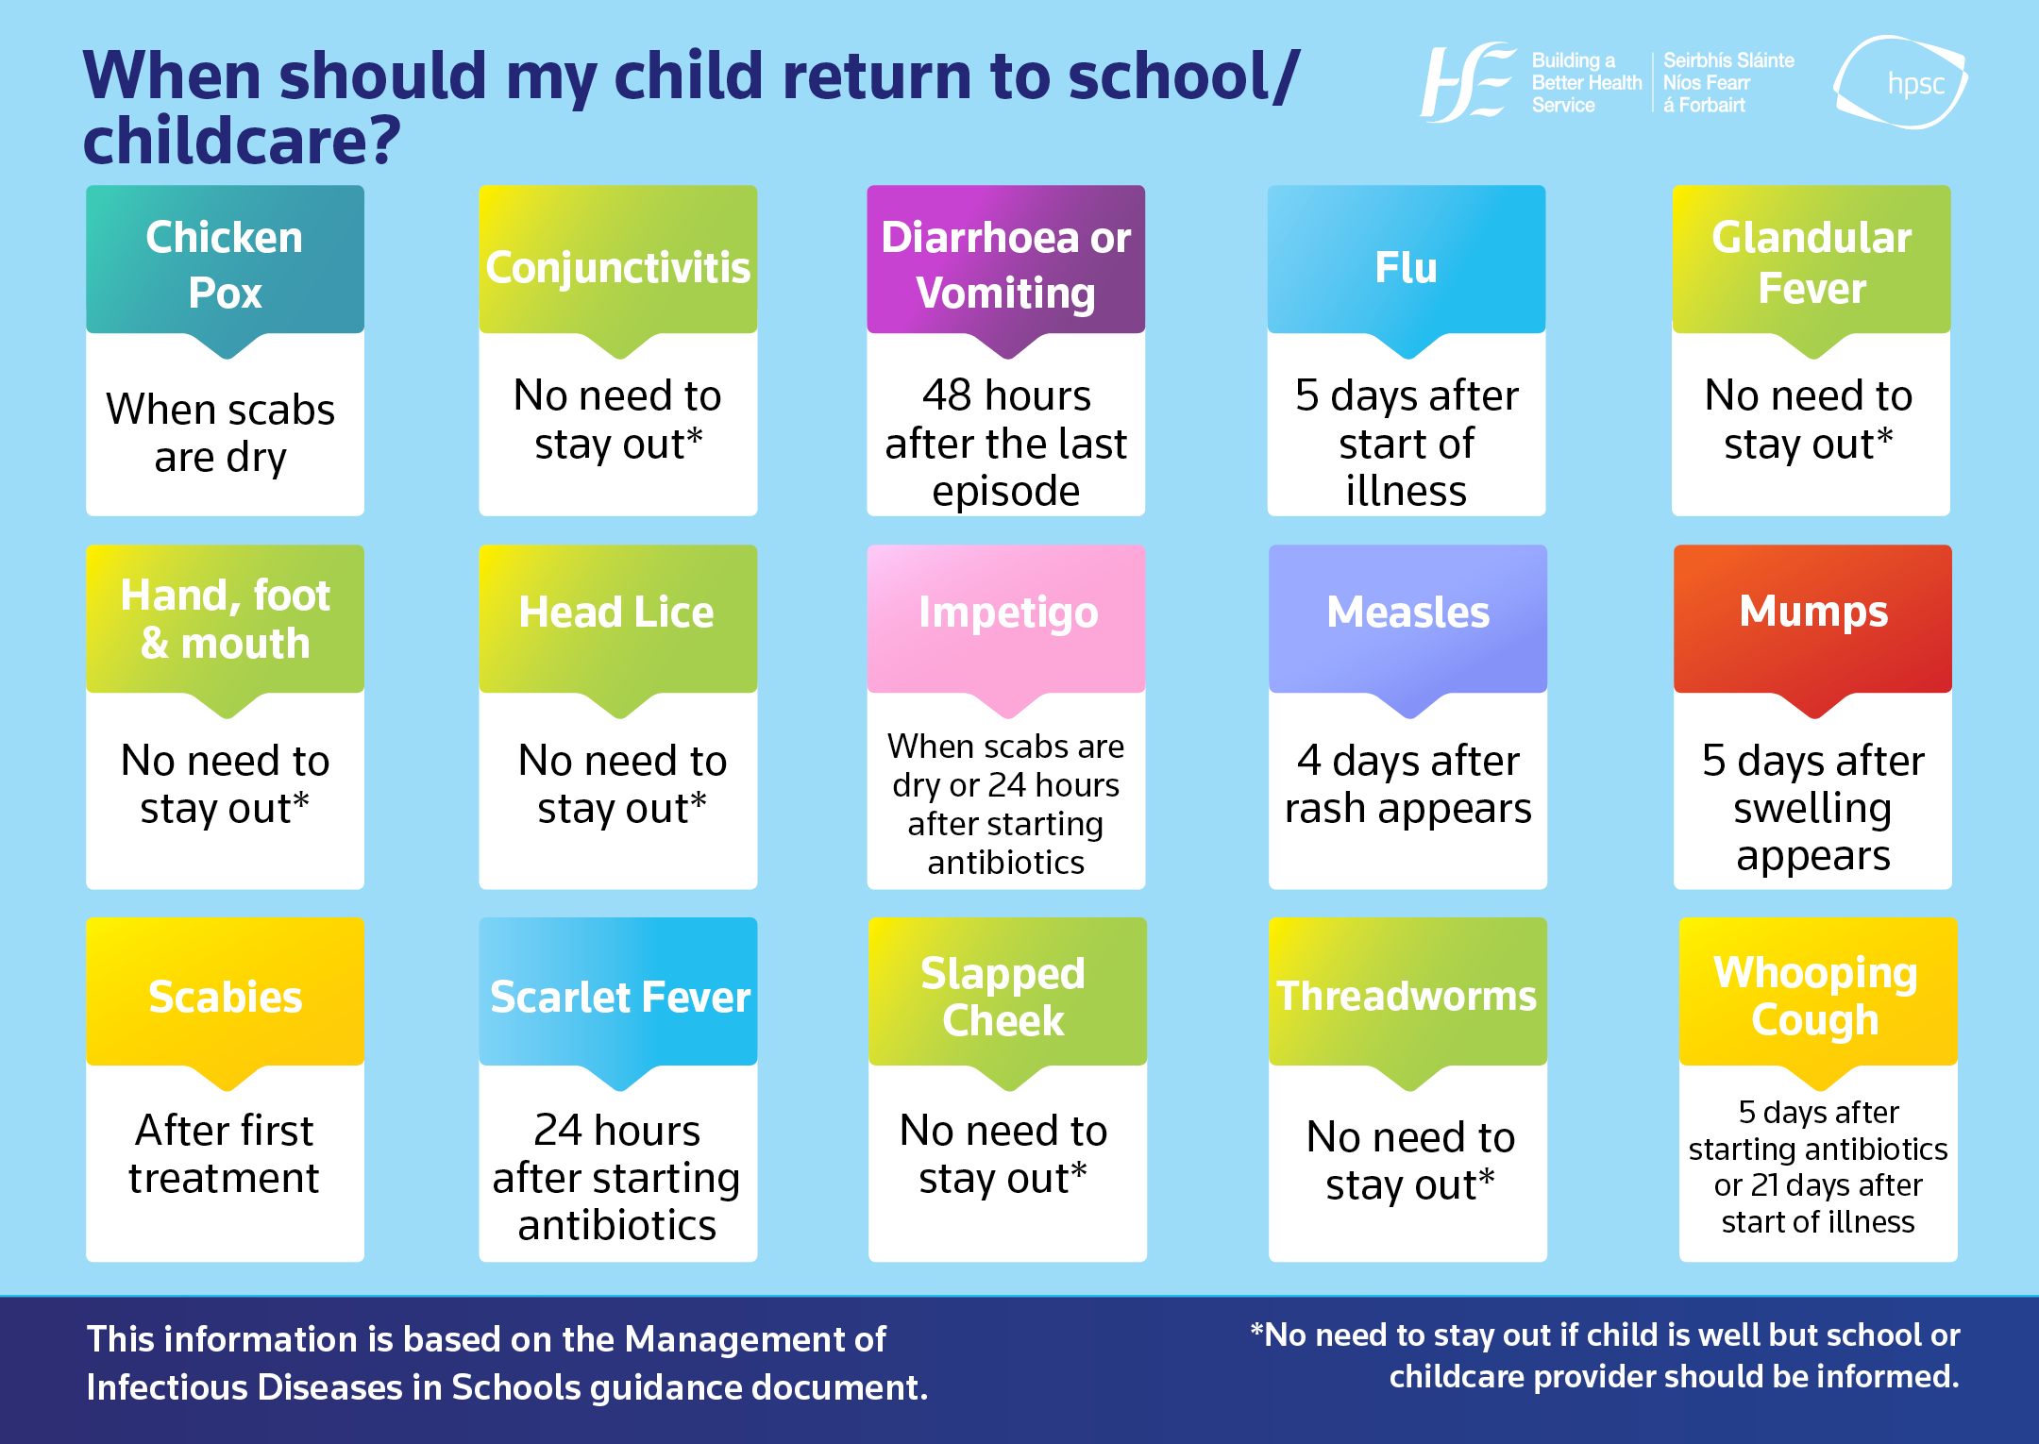
“When can my child go back to school?”
Notes:
https://www.hpsc.ie/a-z/lifestages/childcare/whenshouldmychildreturntoschoolchildcare/School%20Return%20English.png

Slide 37
“ I’m just not happy with him” / The worried parent.
The evil twin.
The rule of 3.
Temp under 3 months – admit.
Create a habit of writing “good” notes.

Slide 39
gpintern.com
See you soon ☺

